Slide 1
GBM Case Studies
Dr Janet Schloss (PhD)
Clinical Research Fellow
Faculty of Health

Slide 2
Background
Why did I start a Phase 2 Trial on
Immune 12?
Prior Familiarity with Product | Published Case Study
Reviewed anecdotal studies on patient experiences with product. | ONCO Study Marine derived Therapeutics for the Management of Glioblastoma: A Case Series and Comprehensive Review of the Literature
3

Slide 3
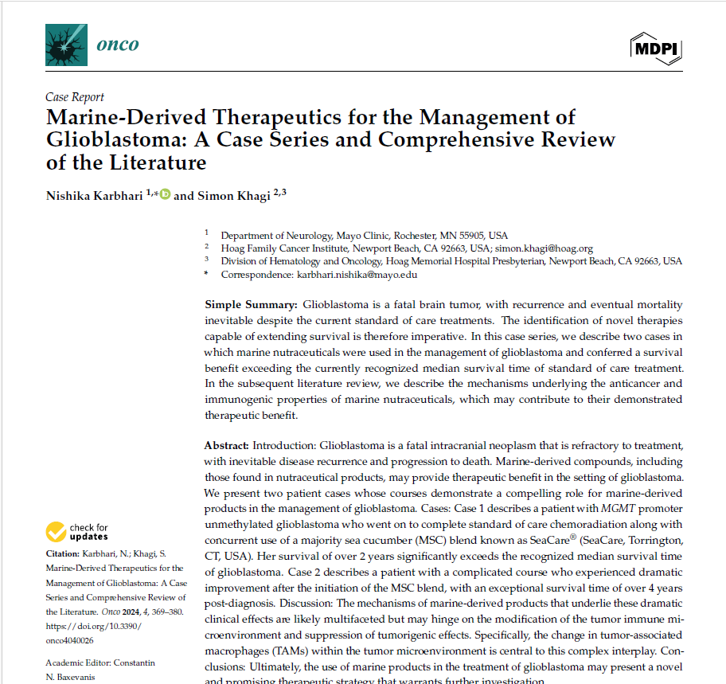

Slide 4
Background
Two case studies will be discussed who commenced taking IMMUNE-12 at different times
Case Study 1 | Case Study 2
Female, 42 at diagnosis in 2022 GBM- IDH wild type, 9cm tumour Methylated, MGMT promoter Completed First line treatment with 12 months of high dose TMZ July 2023 Recurrence July 2023, commenced trial: Attack One trial October 2023 Nov 2023 –extensive recurrence now in corpus callosum Dec 5, 2023 – commenced IMMUNE-12 | Male, 46 at diagnosis in 2023 GBM-IDH wild type 3 tumours – Frontal lobe right (craniotomy – debulking), frontal lobe left, corpus collosum Hypermethylated EGFR mutation Commenced IMMUNE-12 post radiation and low dose TMZ MRI a week before commencing high dose TMZ
3

Slide 5
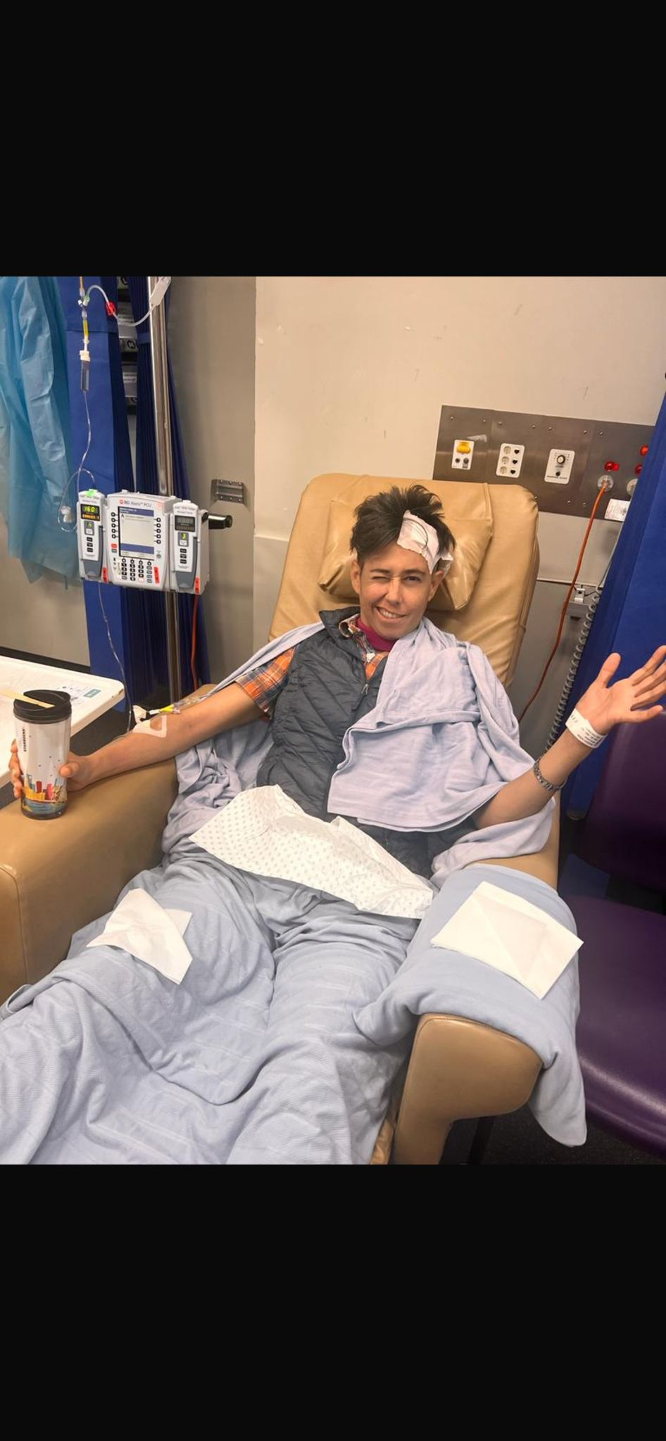
Case Study 1
late May - late June 2022 | Lethargy, headaches, light nausea, bouts of crying
29 June 2022 (7pm) | First MRI
30 June 2022 (9am) | Second MRI with contrast
30 June 2022 (approx. 1pm) | Admitted to hospital
7 July 2022 | Craniotomy to debulk tumour (95% removed) Medication – Keppra 1000mg BD, dexamethasone
21 July 2022 | First consult with Dr. Janet Schloss Vitamin D3, Zinc, Lion’s mane, Turkey Tail, medicinal cannabis Modified keto diet
1 August 2022 | Commenced radiation and low dose TMZ (6 weeks) FIG TRIAL
25th August, 2022 | Second consult with Dr. Janet Schloss Commenced Boswellia, turmeric, nigella sativa
12 Sept to 9 October 2022 | Break from TMZ
10 October 2022 to August 2023 | Resumed higher dose TMZ 5 consecutive days every 4 weeks.
July 2023 | MRI shows possible recurrence near corpus collosum Keto nutrition commences under Dr. Alex Petrushevski’s guidance. HBOT and red-light therapy commences
Late August 2023 | MRI confirms recurrence. TMZ stopped
5

Slide 6
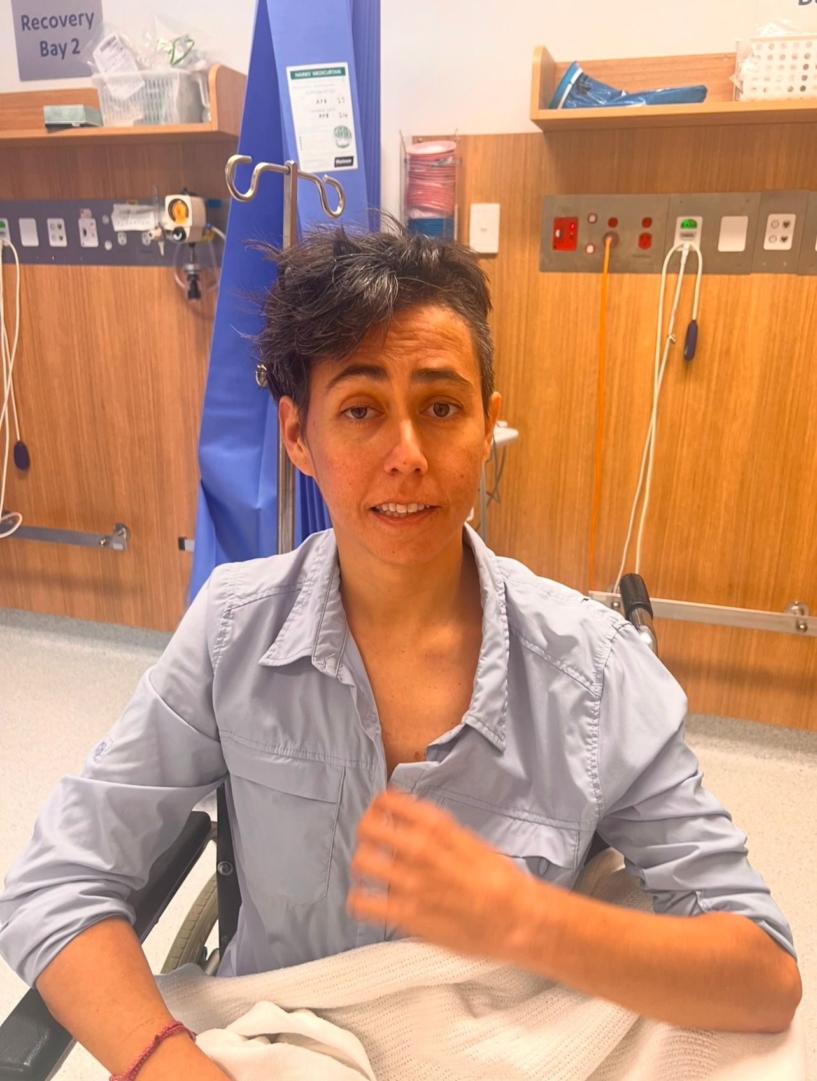
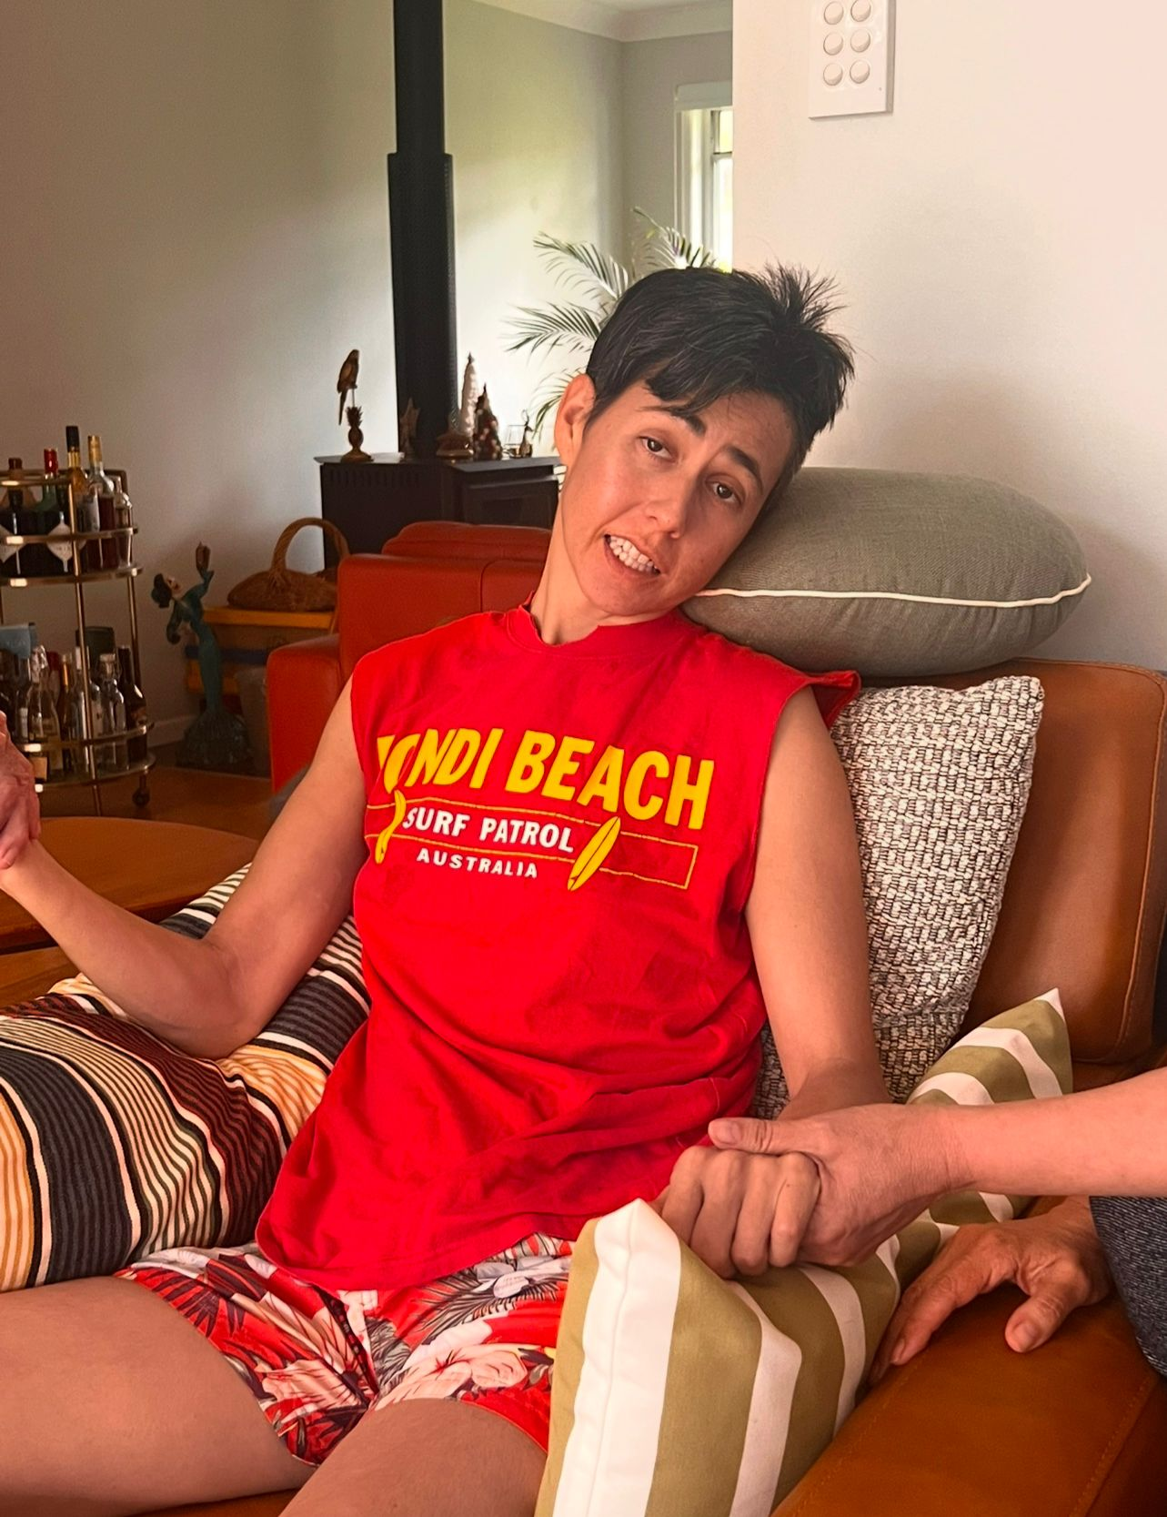
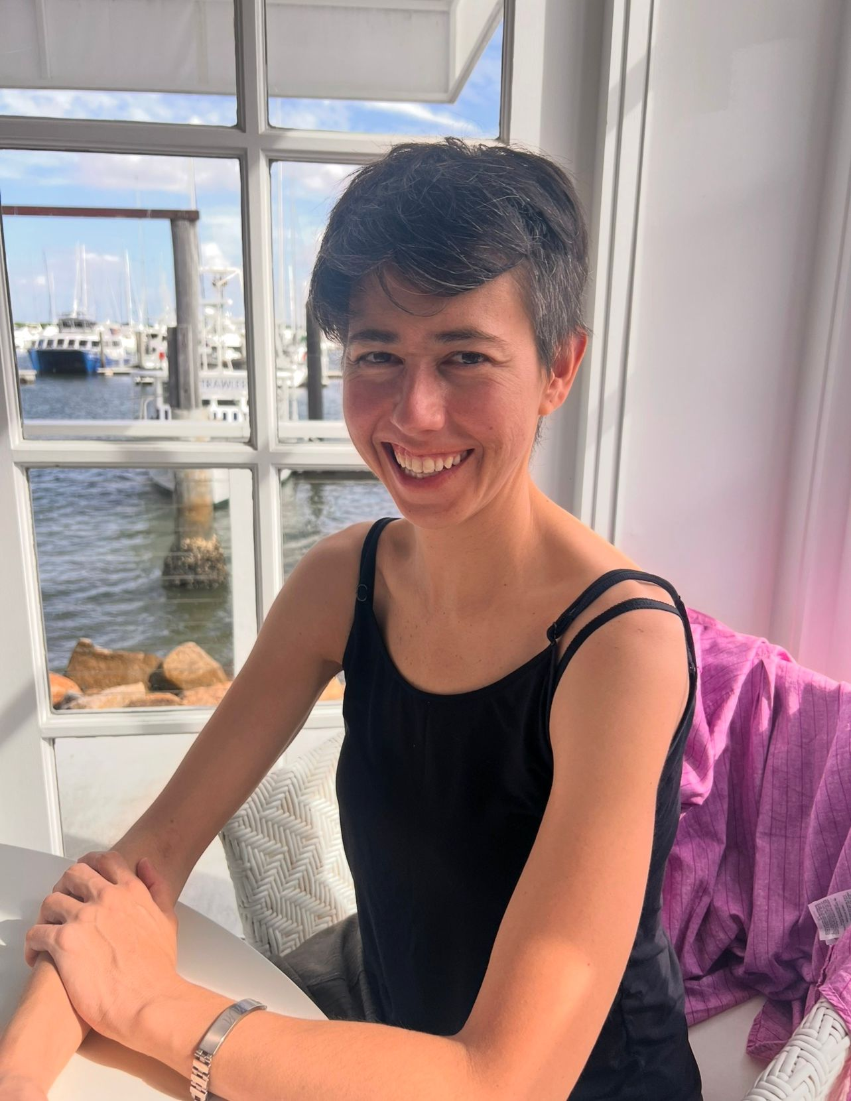
Case Study 1
7 November 2023 | MRI shows extensive growth of recurrence now in corpus callosum Genetic sequencing results show extremely high levels of mutation. Immunotherapy identified as possible avenue. Drug company agrees to compassionate case supply of 4 infusions (administered every 3 weeks). Fluid in brain not draining. Possible shunt procedure needed prior to commencing immunotherapy,
14 November 2023 | 1st shunt surgery Medication: Keppra Blockage on and off until balance is significantly impacted
2 December 2023 | 2nd shunt surgery Medication: Keppra
5 December 2023 | IMMUNE-12 treatment begins under Dr. Janet Schloss/Samuel Grant guidance. Ongoing YTD (Jan 2025) 2x sachets in the morning after meal 2x sachets in the evening after meal
11 December 2023 | Immunotherapy commences IPILIMUMAB and NIVOLUMAB - intravenous Medication: Keppra Double dose of supplement intake (Boswellia, Curcumin, Nigella Sativa) Increase dose of CBG (1.5mls x morning and evening) CBD 1ml in the evening
29 December 2023 | MRI shows some tumor growth
3 January 2024 | 2nd immunotherapy dose IPILIMUMAB and NIVOLUMAB - intravenous Medication: Keppra
22 January 2024 | 3rd immunotherapy dose IPILIMUMAB and NIVOLUMAB - intravenous Medication: Keppra
10 February 2024 | MRI shows reduction of tumour
14 February 2024 | 4th immunotherapy dose IPILIMUMAB and NIVOLUMAB - intravenous Medication: Keppra
March 2024 YTD Jan 2025 | Maintenance immunotherapy continues 1x 4 weeks NIVOLUMAB

Slide 7
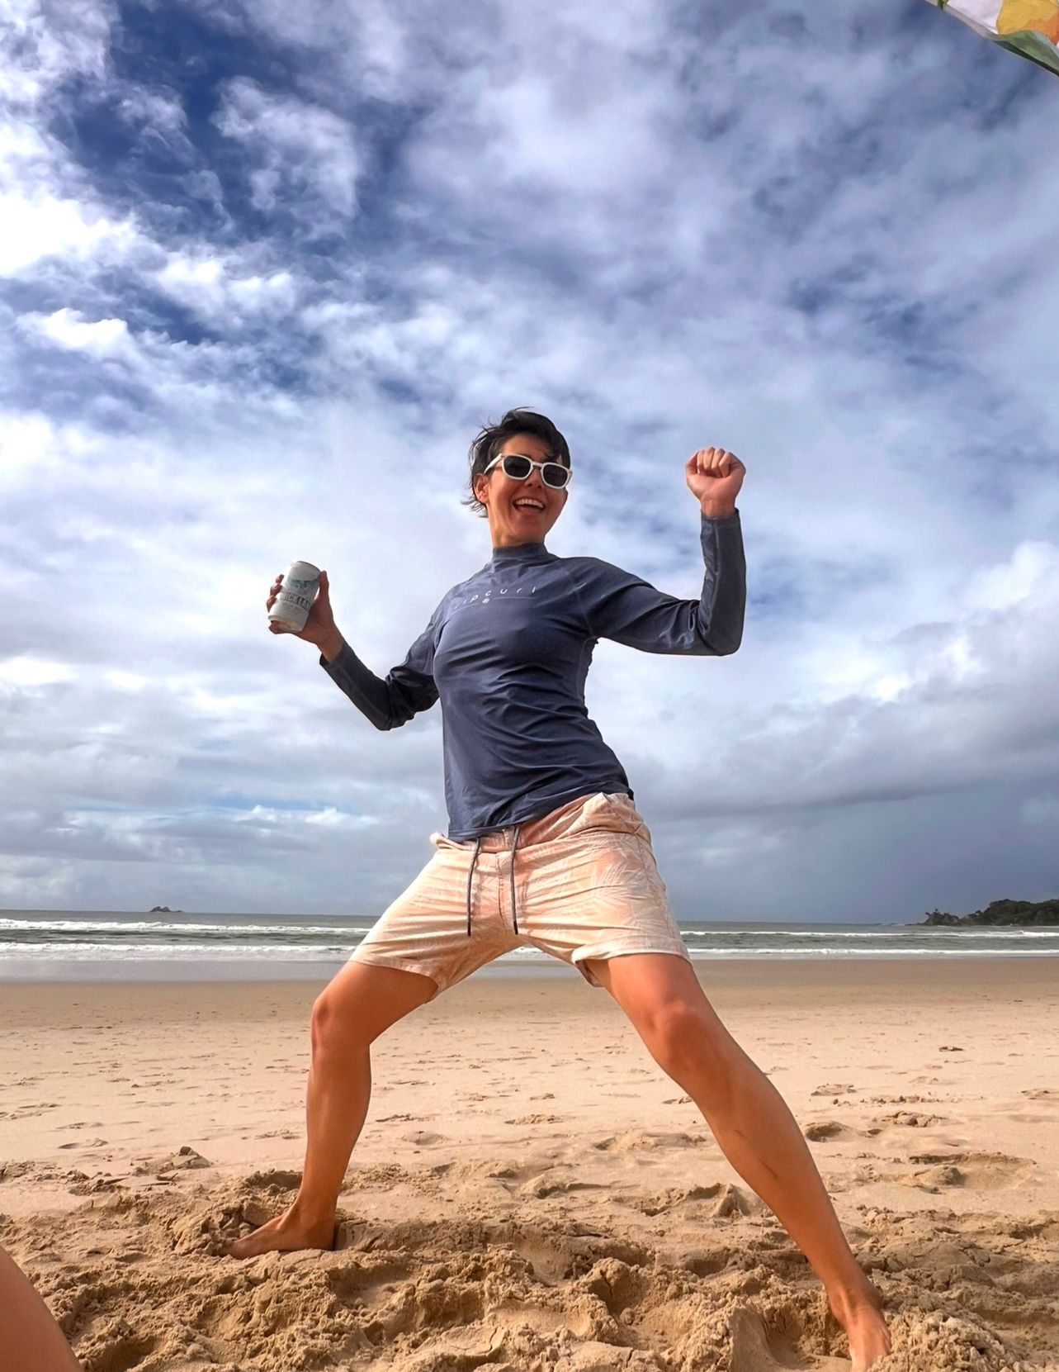
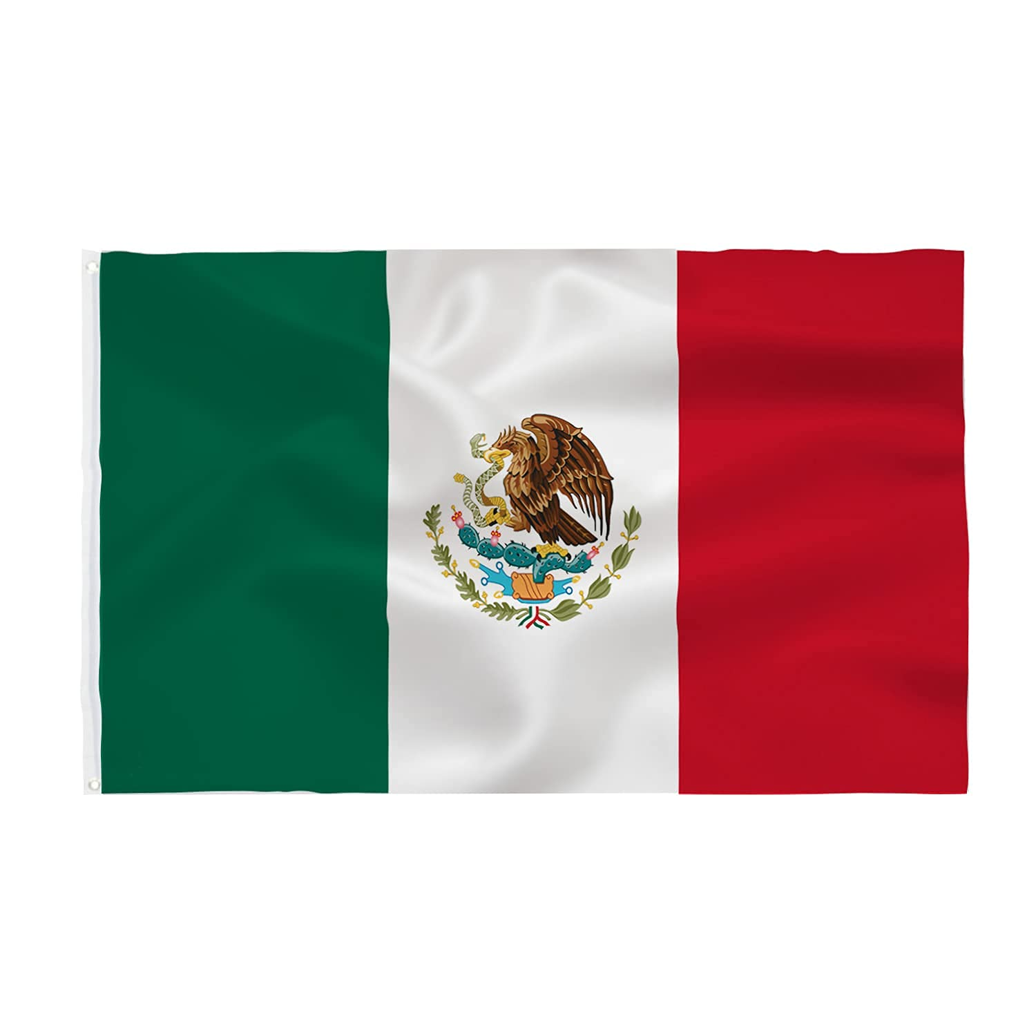
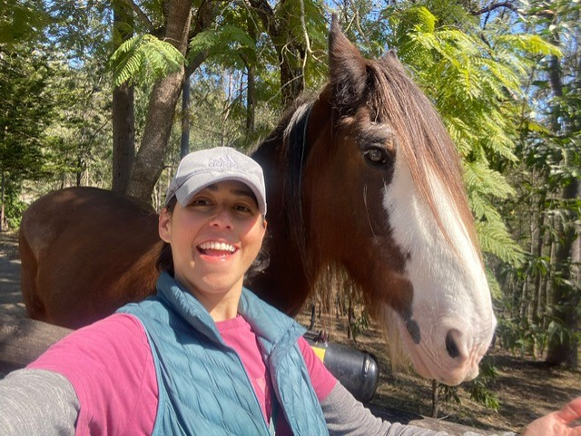
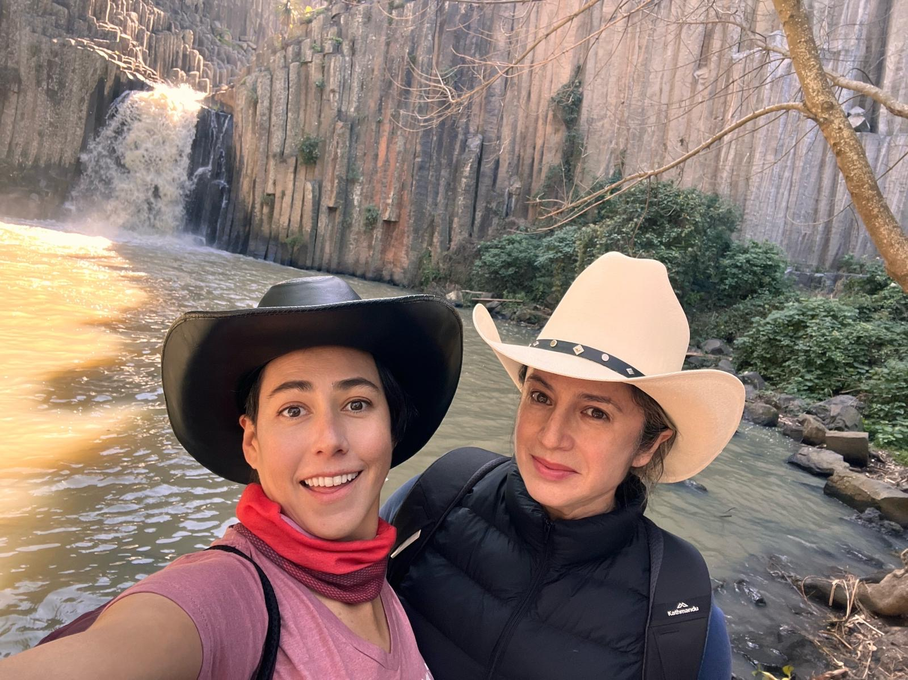
Case Study 1
May 2024 | Keppra intake stops
23 May August 2024 | MRI shows NO EVIDENCE OF DISEASE
16 August 2024 | MRI shows NO EVIDENCE OF DISEASE
8 Nov 2024 | MRI shows NO EVIDENCE OF DISEASE
NEXT SCHEDULED MRI 13 FEB 2025 | HOPING FOR NED!!!
7

Slide 8
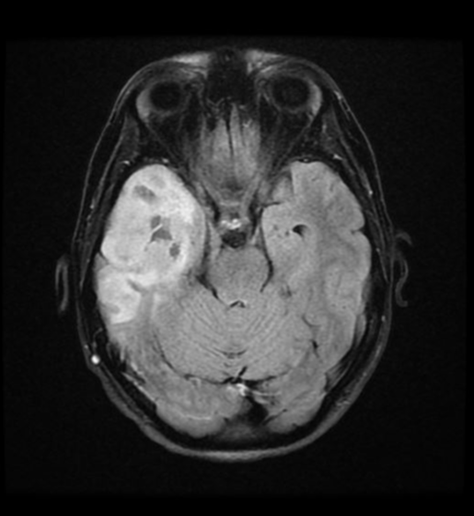
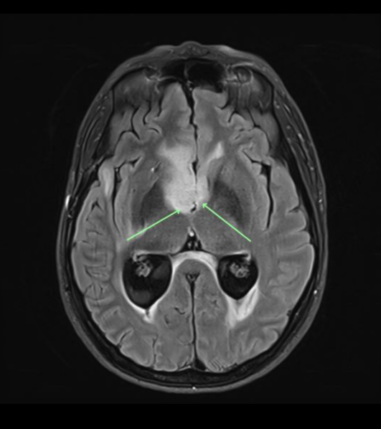
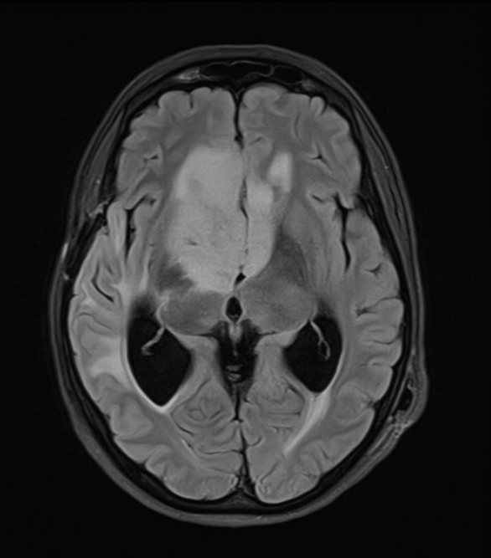
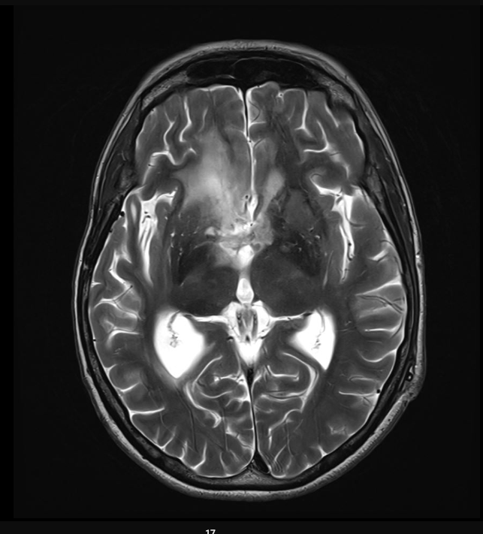
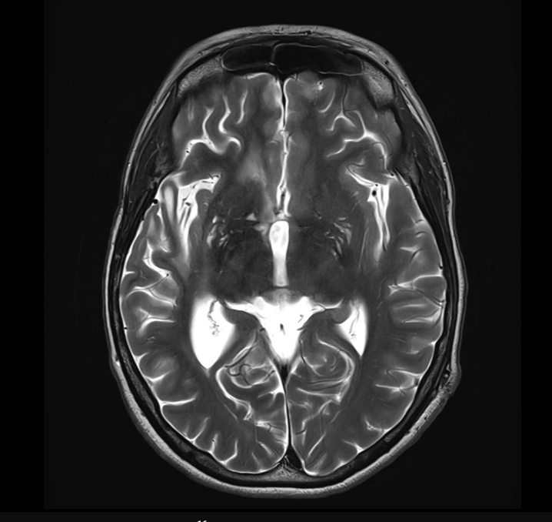
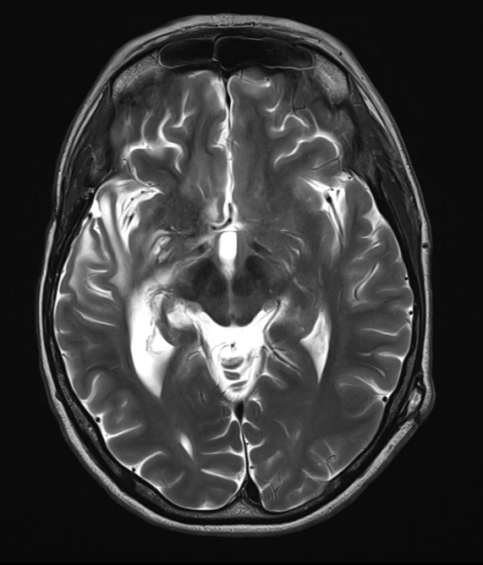
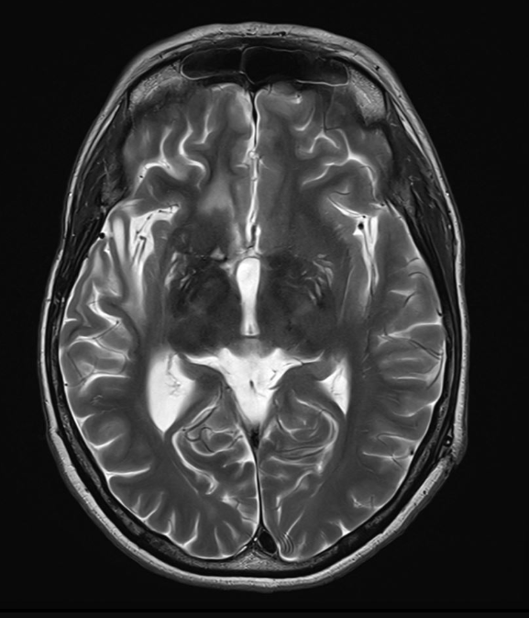
Case Study 1
Initial MRI 30th June 2022
MRI 7th November 2023
MRI 29th December 2023
6
MRI 10th February, 2024
MRI 23rd May, 2024 - NED
MRI 16th August, 2024 - NED
MRI 8th November, 2024 - NED

Slide 9
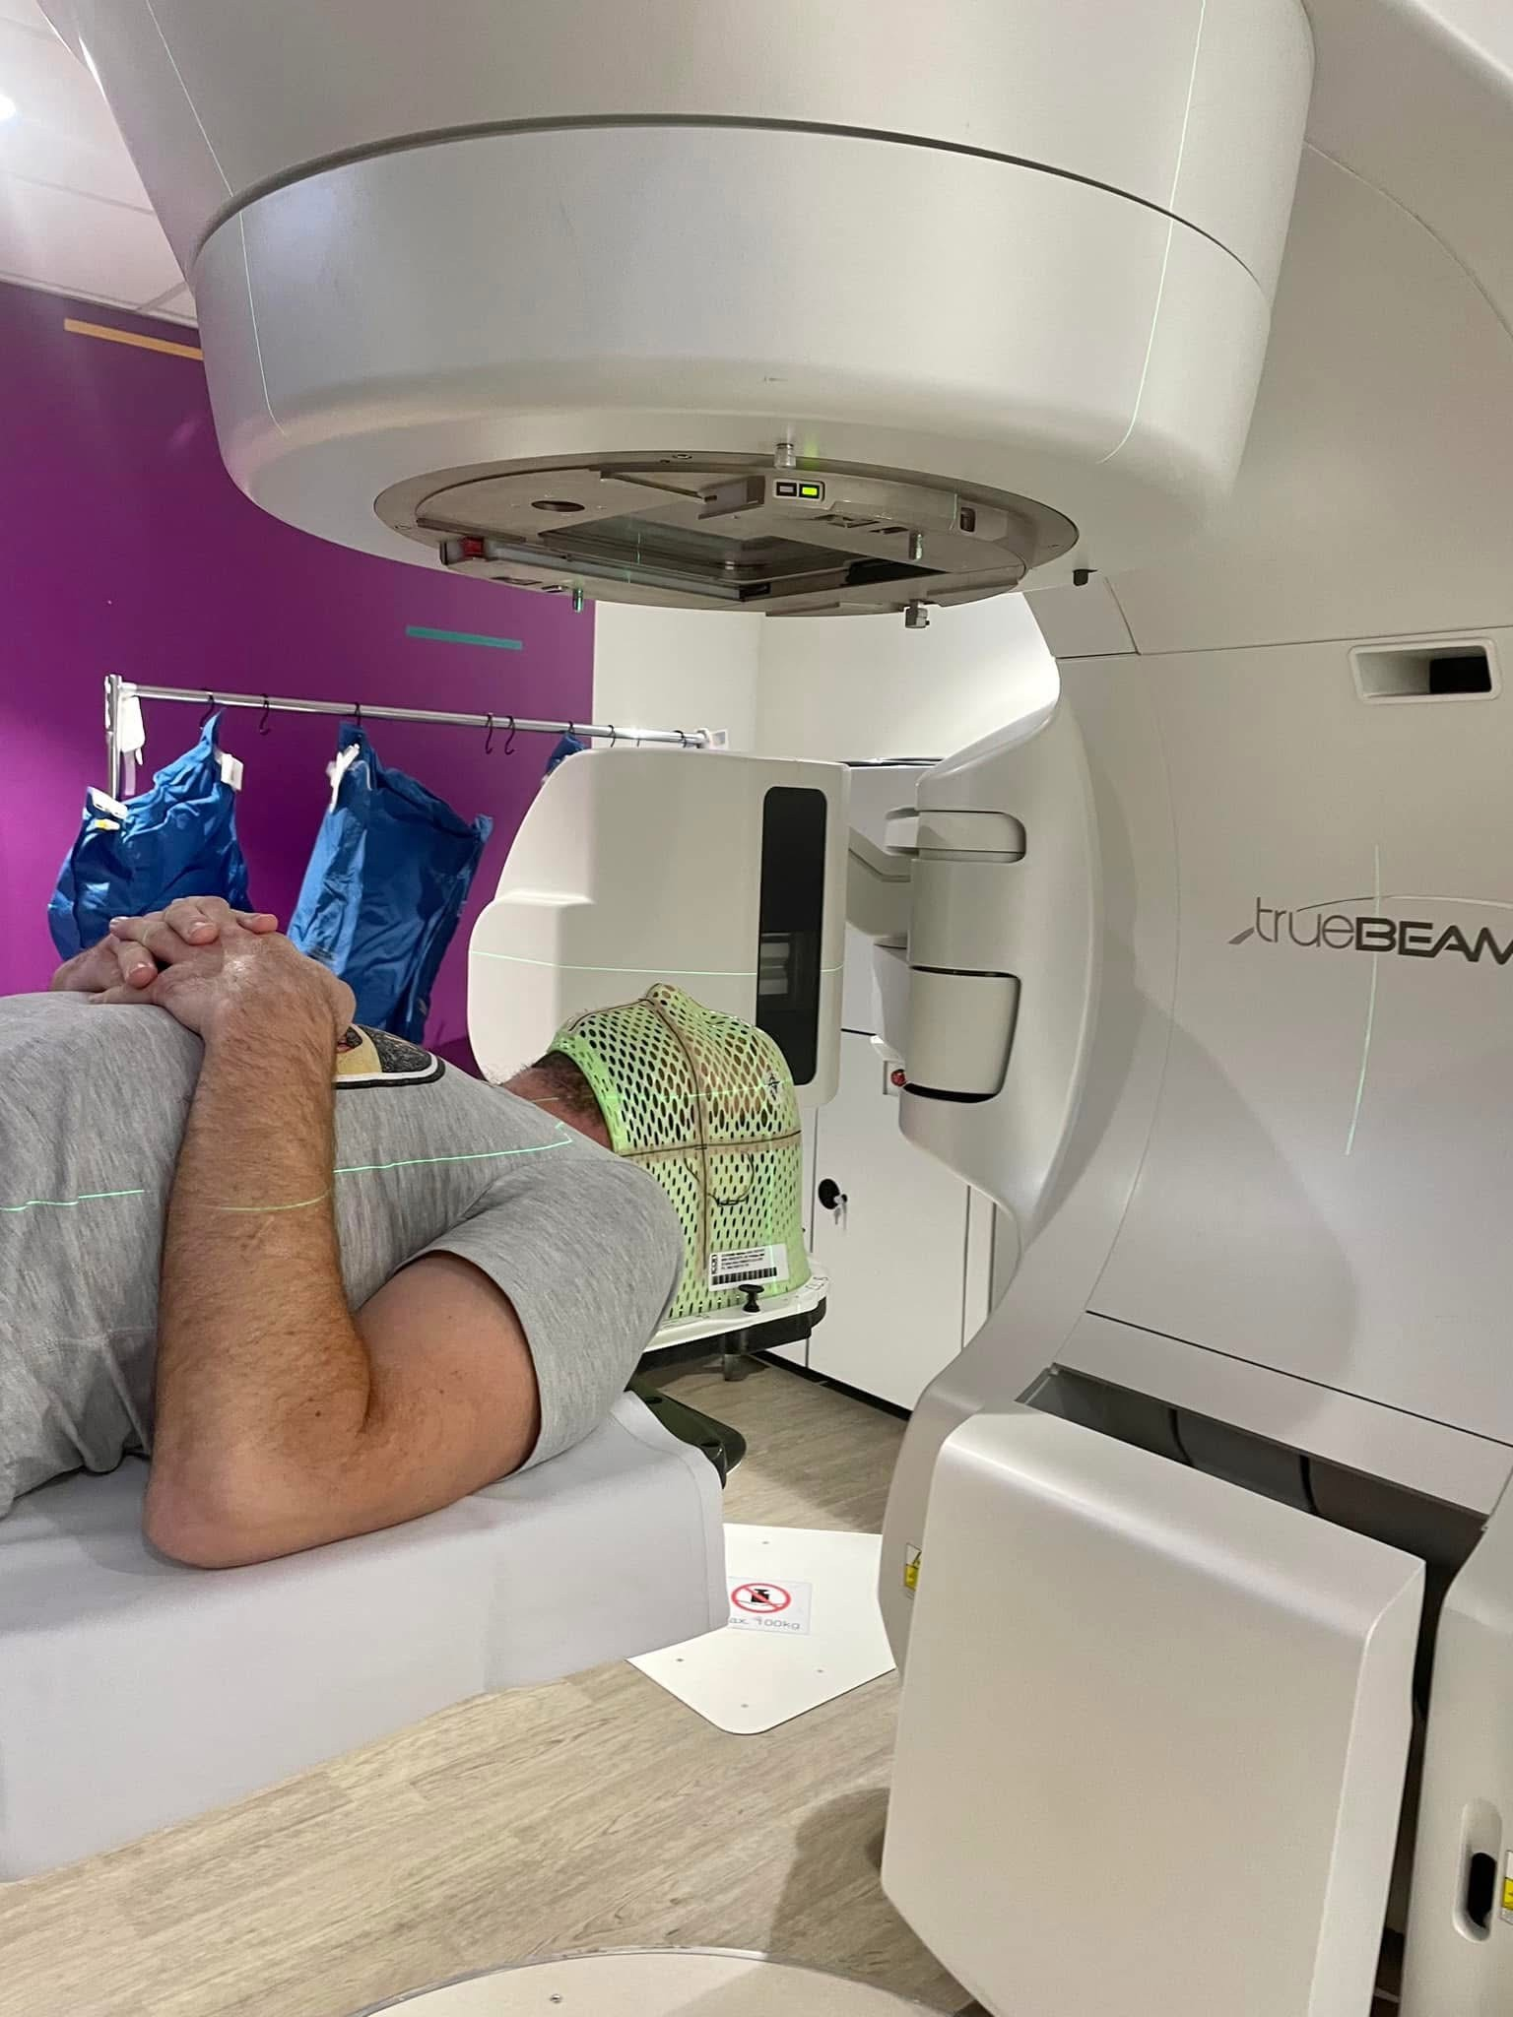
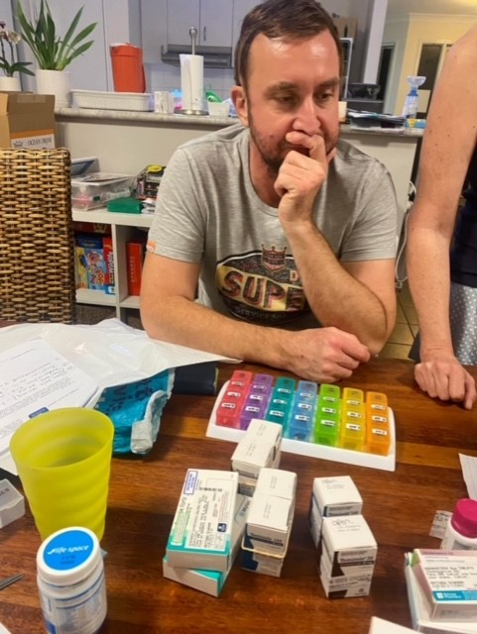
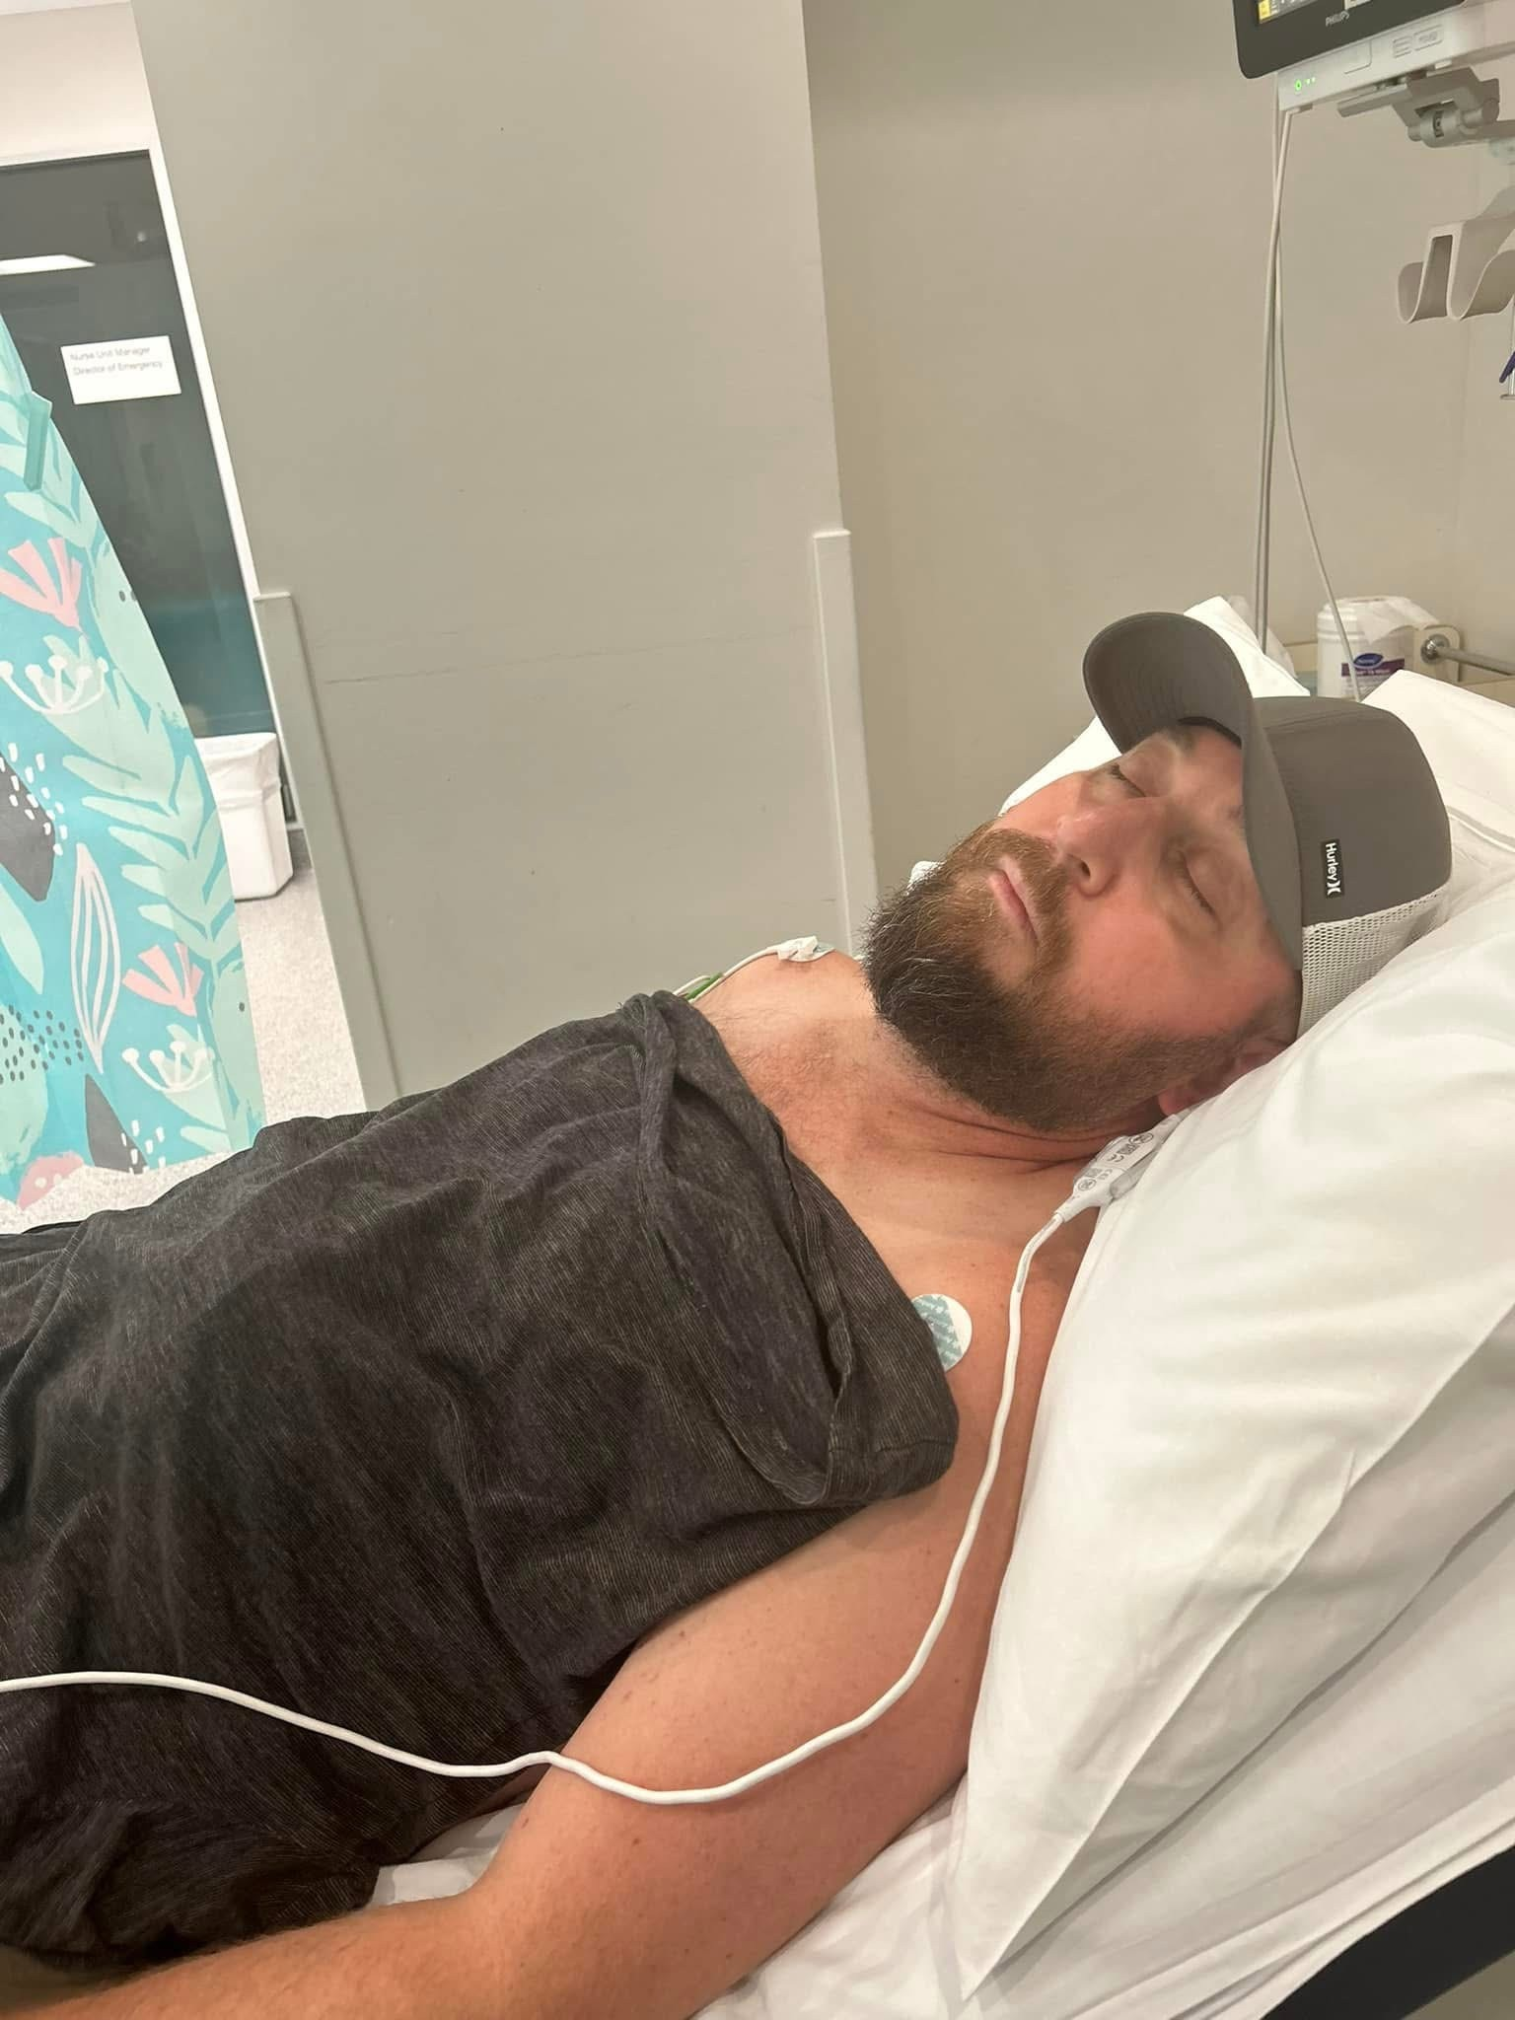
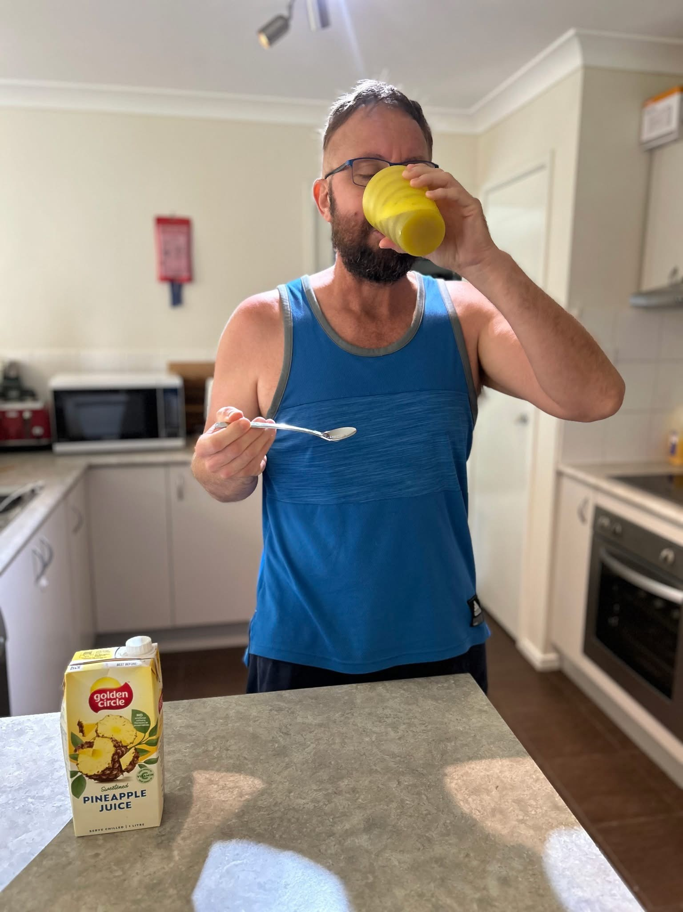
Case Study 2
September 2023 | Craniotomy
 | Radiation and low dose TMZ
28 November 2023 | MRI post radiation and low dose TMZ. Resection cavity right frontal lobe reduced in volume. Now 19x18mm in diameter (previously 31x34mm). Nodular enhancement at posterior margin of resection cavity has reduced slightly in volume. Left frontal lobe has reduced in size, now 22x19mm in diameter (previously 26x21mm) – demonstrates mild increased cerebral blood flow. Corpus callosum has decreased in size, now 13x12mm in diameter (previously 15x16mm) demonstrates increased blood volume Vitamin D3, Zinc, Lion’s mane, Turkey Tail, medicinal cannabis, Modified keto diet
29 November 2023 | Commenced IMMUNE-12 1 week before high dose TMZ
11 February 2024 | Feet and ankles swelling, Bp sitting 127/79, standing 111/76. Experiencing dizziness on standing. Has to urinate numerous times during the night. Under Urologist.
21 February 2024 | MRI – contrast was unable to be conducted due to cannula malfunction. Indicates right frontal craniotomy with post treatment changes. Two lesions seen, left frontal lobe and corpus callosum. Both lesions have not changed significantly in size.
18 March 2024 | A&E (ED) – BP spiked at 184/112, headaches, nausea, blurred vision, sensitive to light. Worried about kidney function. Lipase 40 (0-80), Haemolysis index 5 (<40), CRP 1.2 (<5), hs Troponin 2 (<26), Urea 8.6 (3-8), creatine 171 (60-110), eGFR 41 (>59), Platelets 115 (150-400), APTT 22 (23-38), Hb 113 (135-15), RCC 3.3 (4.5-6.5), Lymphocytes (0.31 (1-4), WCC 4.1 (3.5-10). All other bloods NCS. Under Cardiologist
8

Slide 10
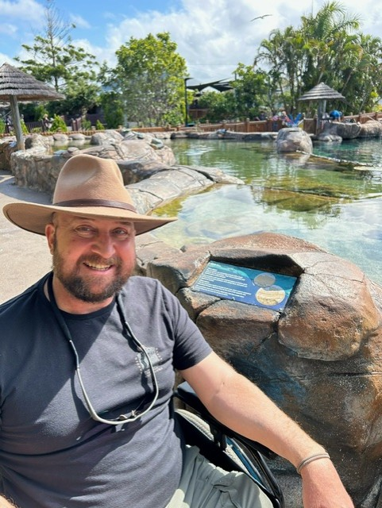
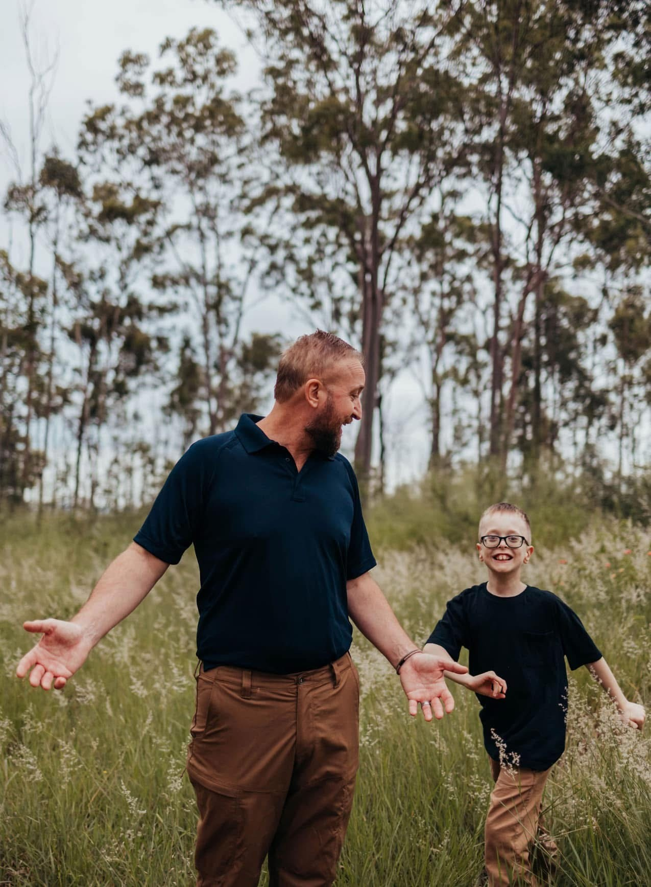
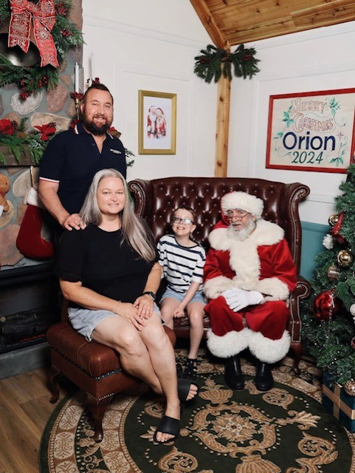
Case Study 2
29 May 2024 | MRI – Right frontal lobe craniotomy site has decreased in size, now 11mm in diameter, left frontal lobe has decreased in size measuring 18x15mm and corpus callosum has reduced in size now measuring 10mm in diameter. No new lesions, no hydrocephalus. Craniocervical junction appears normal.
21 July 2024 | Got Influenza A
7th August 2024 | MRI – Right frontal lobe stable with collapsing cavity, left frontal lobe and corpus callosum are stable. No convincing progression. Overlying cortical thickening of right frontal lobe
29 September 2024 | Had first seizure, bit tongue – hospitalized. Treated with Keppra
29 September 2024 | MRI – Right frontal lobe craniotomy shows reduction in volume of the resection cavity. Left frontal lobe has reduced in volume. Corpus callosum has reduced in size and is 8mm in diameter. No hydrocephalus present. Stable non-enhancing disease. No evidence of disease progression or new pathology.
15th October 2024 | Positive for RSV
November 2024 | MRI – Corpus callosum and left frontal lobe remains unchanged in distribution. The nodular enhancement in the anterior inferior aspect of the frontal surgical resection cavity has further reduce in size and conspicuity, now measuring 11mm max in dimension compared to 14mm. No new lesions. Conclusion, further interval reduction, unchanged FLAIR signal, stable disease.
December 2024 | Completed 12 months of high dose TMZ and continues to take IMMUNE-12
9

Slide 11
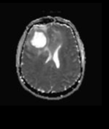
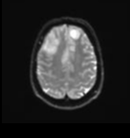
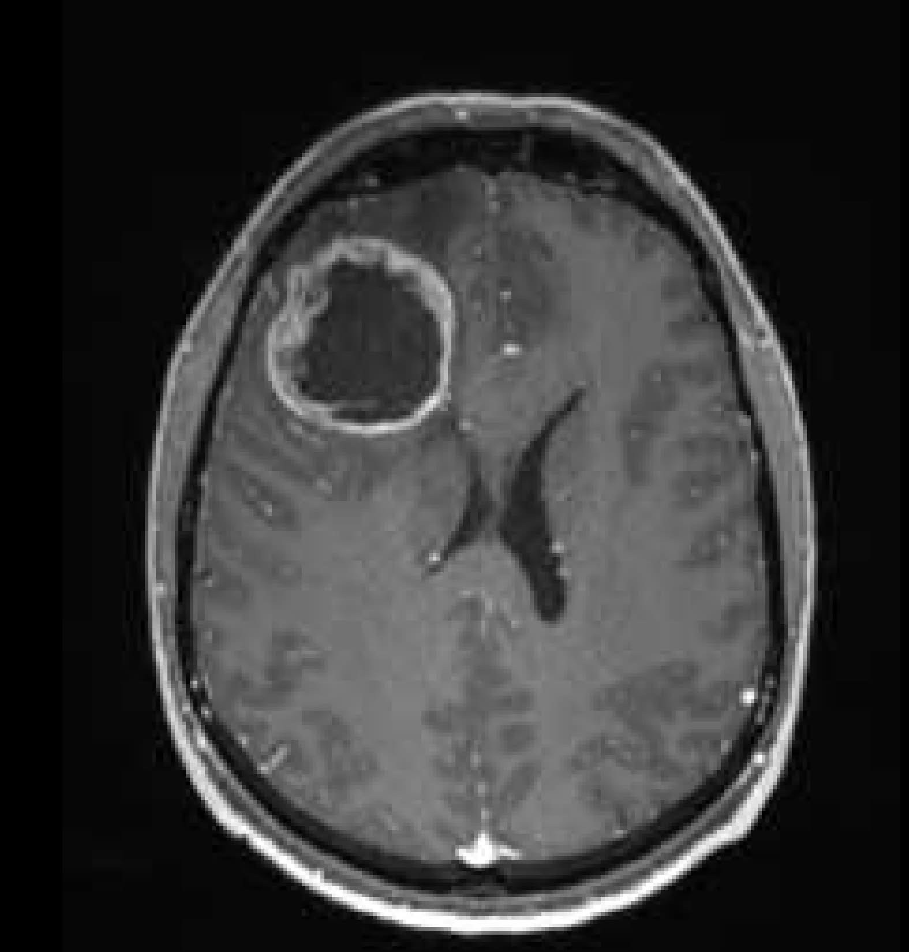
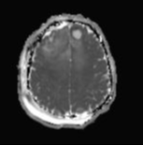
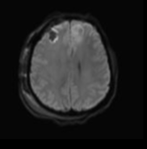
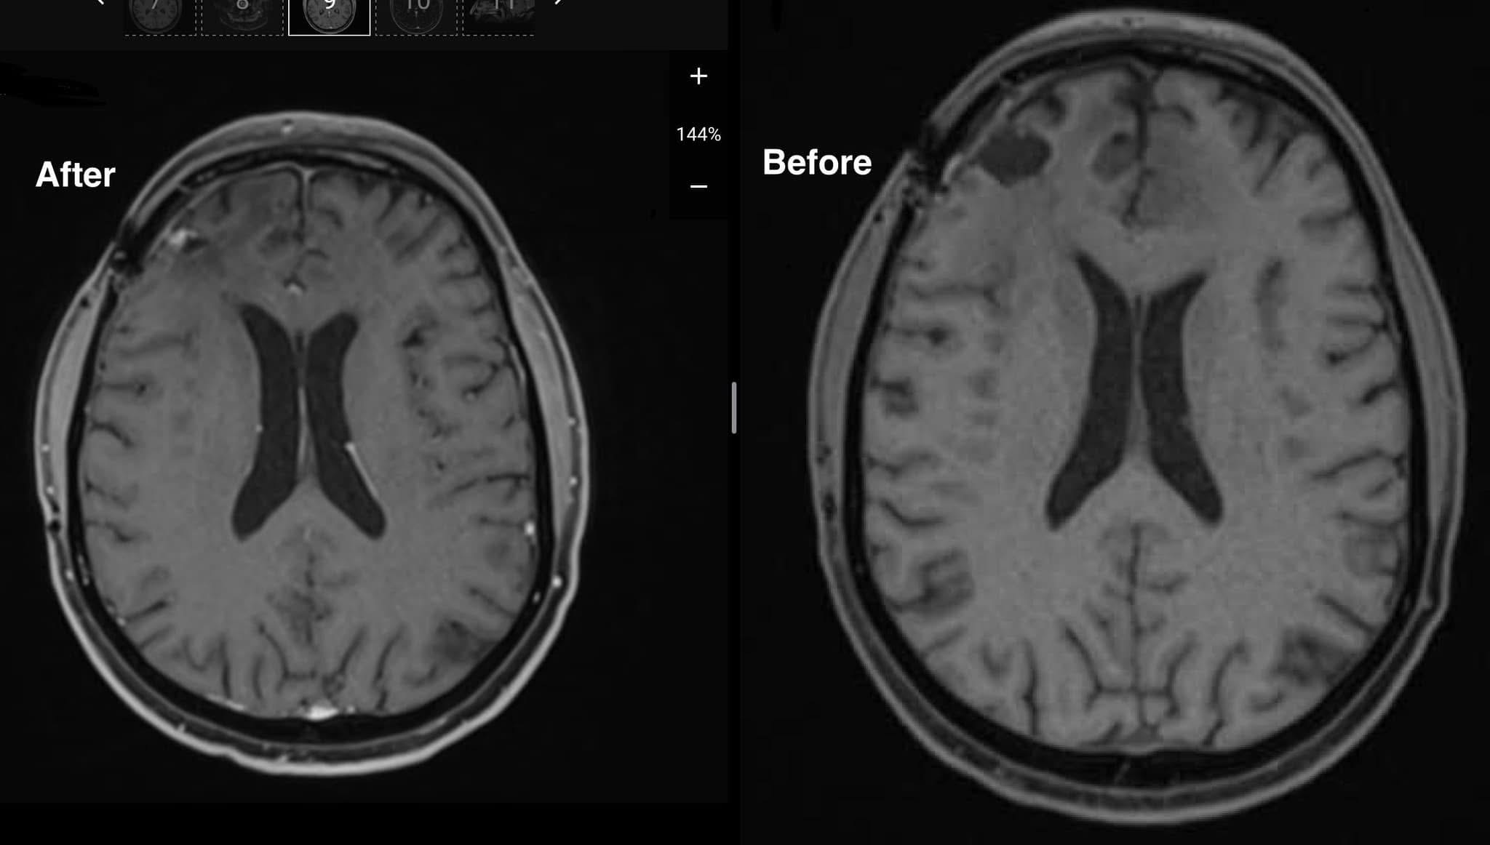
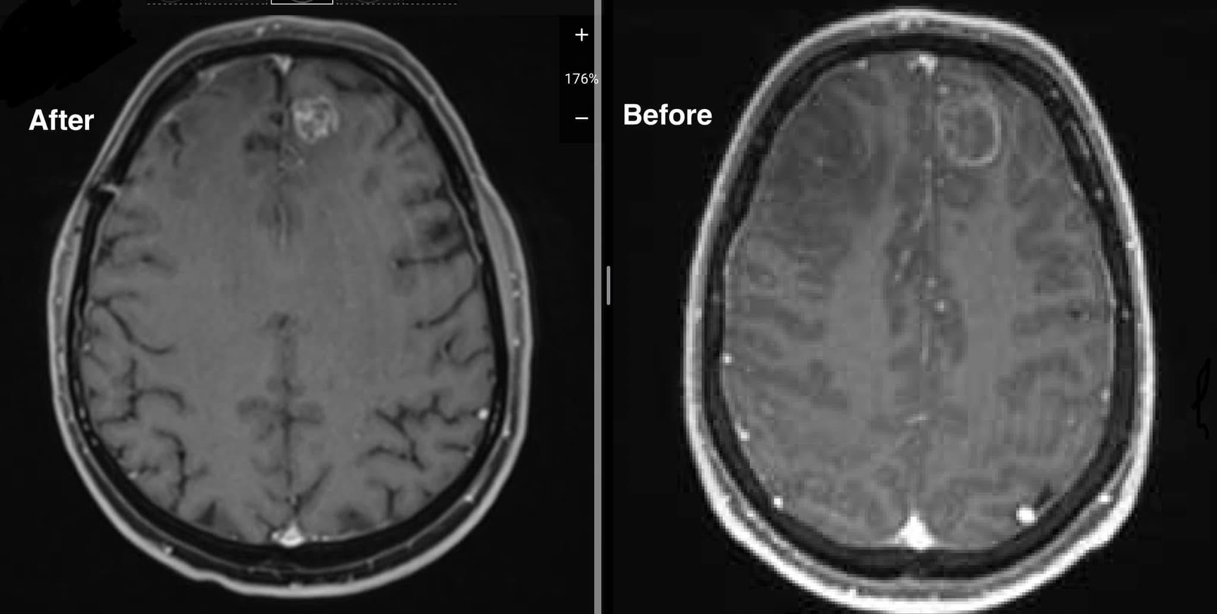
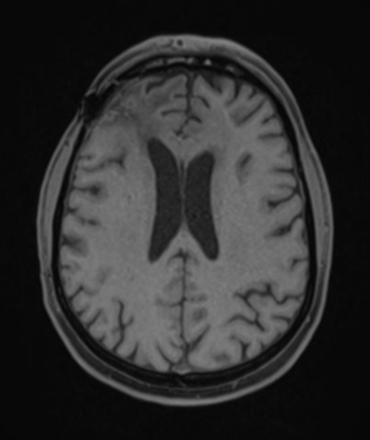
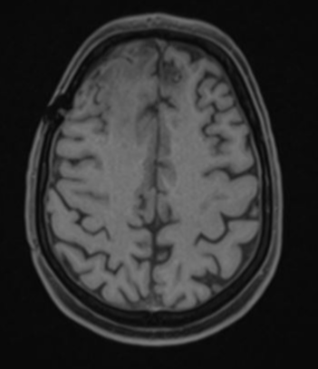
Case Study 2
Right lobe 30 August 2023
Left lobe, CC 30 August 2023
Right lobe November 2023
Left lobe November 2023
Left lobe, CC November 2023
12
Left lobe May compared to Feb 2024
Right lobe Nov 2024
Left lobe Nov 2024
Right lobe May compared to Feb 2024

Slide 12
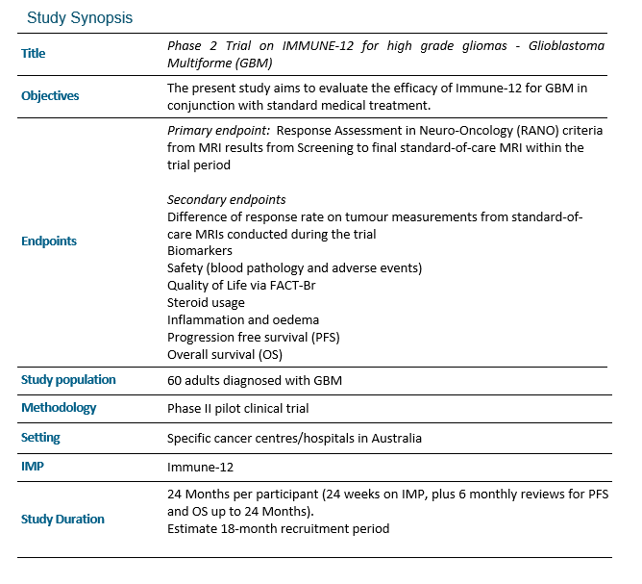
Phase 2 Clinical Trial
[JT1]Can we just ask permission to review medical records to get this info, rather than making phone calls?
[JS2]yes
13
HREC: 2024/ETH02100
ANZCTR: ACTRN12624001484538

Slide 13
Conclusion
IMMUNE-12 shows potential as a novel agent as an adjunct for GBM treatment
Phase II trial in Australia has ethics approval and has commenced
More research is required

