Slide 1
Pre-Clinical Evaluation of the Performance of Immune-12 Andrew Satterlee Assistant Professor Director, Screening Live Cancer Explants Program Eshelman School of Pharmacy University of North Carolina at Chapel Hill

Slide 2
Disclosures
The Satterlee Lab and the Screening Live Cancer Explants Core Facility at UNC are conducting ongoing sponsored/contracted research for Pacific Marine Biotech.

Slide 3
Pre-Clinical Scope of Work
Evaluate Antitumor Potency of Immune-12
Characterize the Makeup of Immune-12
Determine How Immune-12 is Working

Slide 4
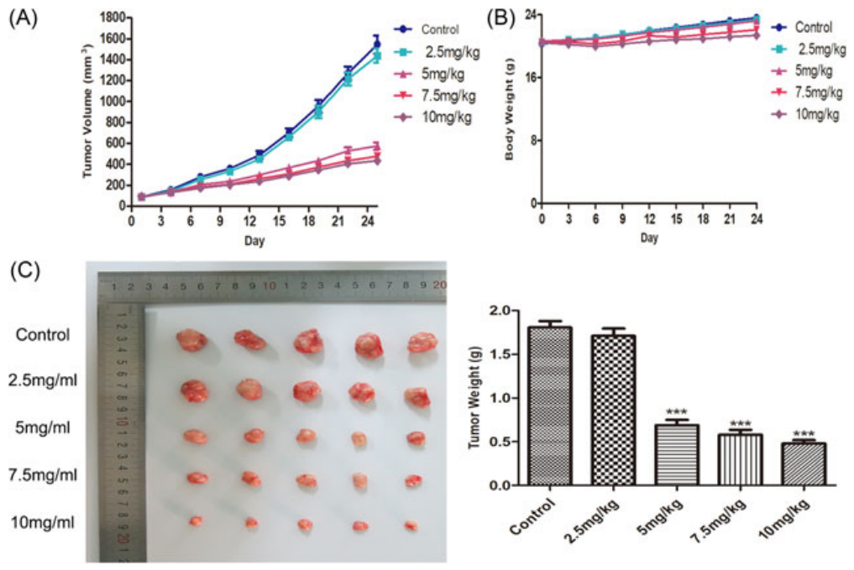
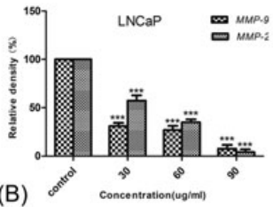
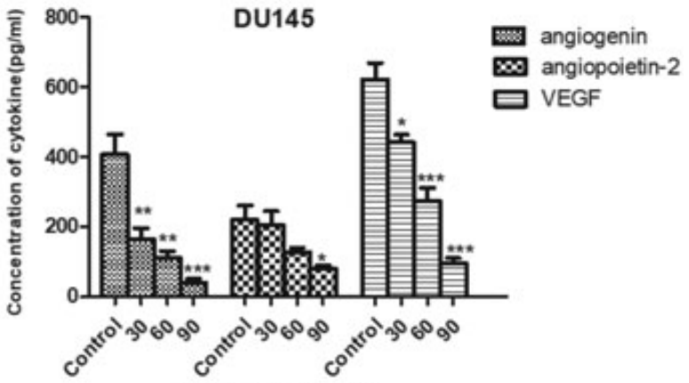
Previously Published Data on Immune-12 in Prostate Cancer
Immune-12 Induces Tumor Growth Inhibition in Mice
Immune-12 Affects Protein Profiles of Cancer Cells
Yuan et al, The Prostate. 2019;79:826–839.

Slide 5
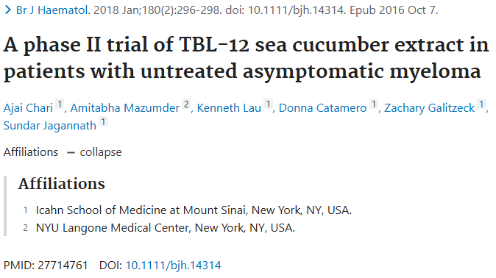
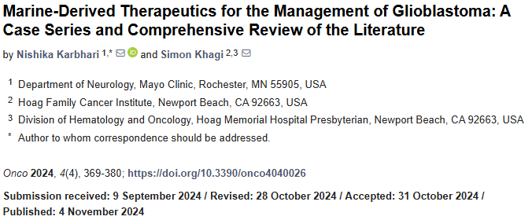
Previously Published Data on Immune-12 in Prostate Cancer

Slide 6
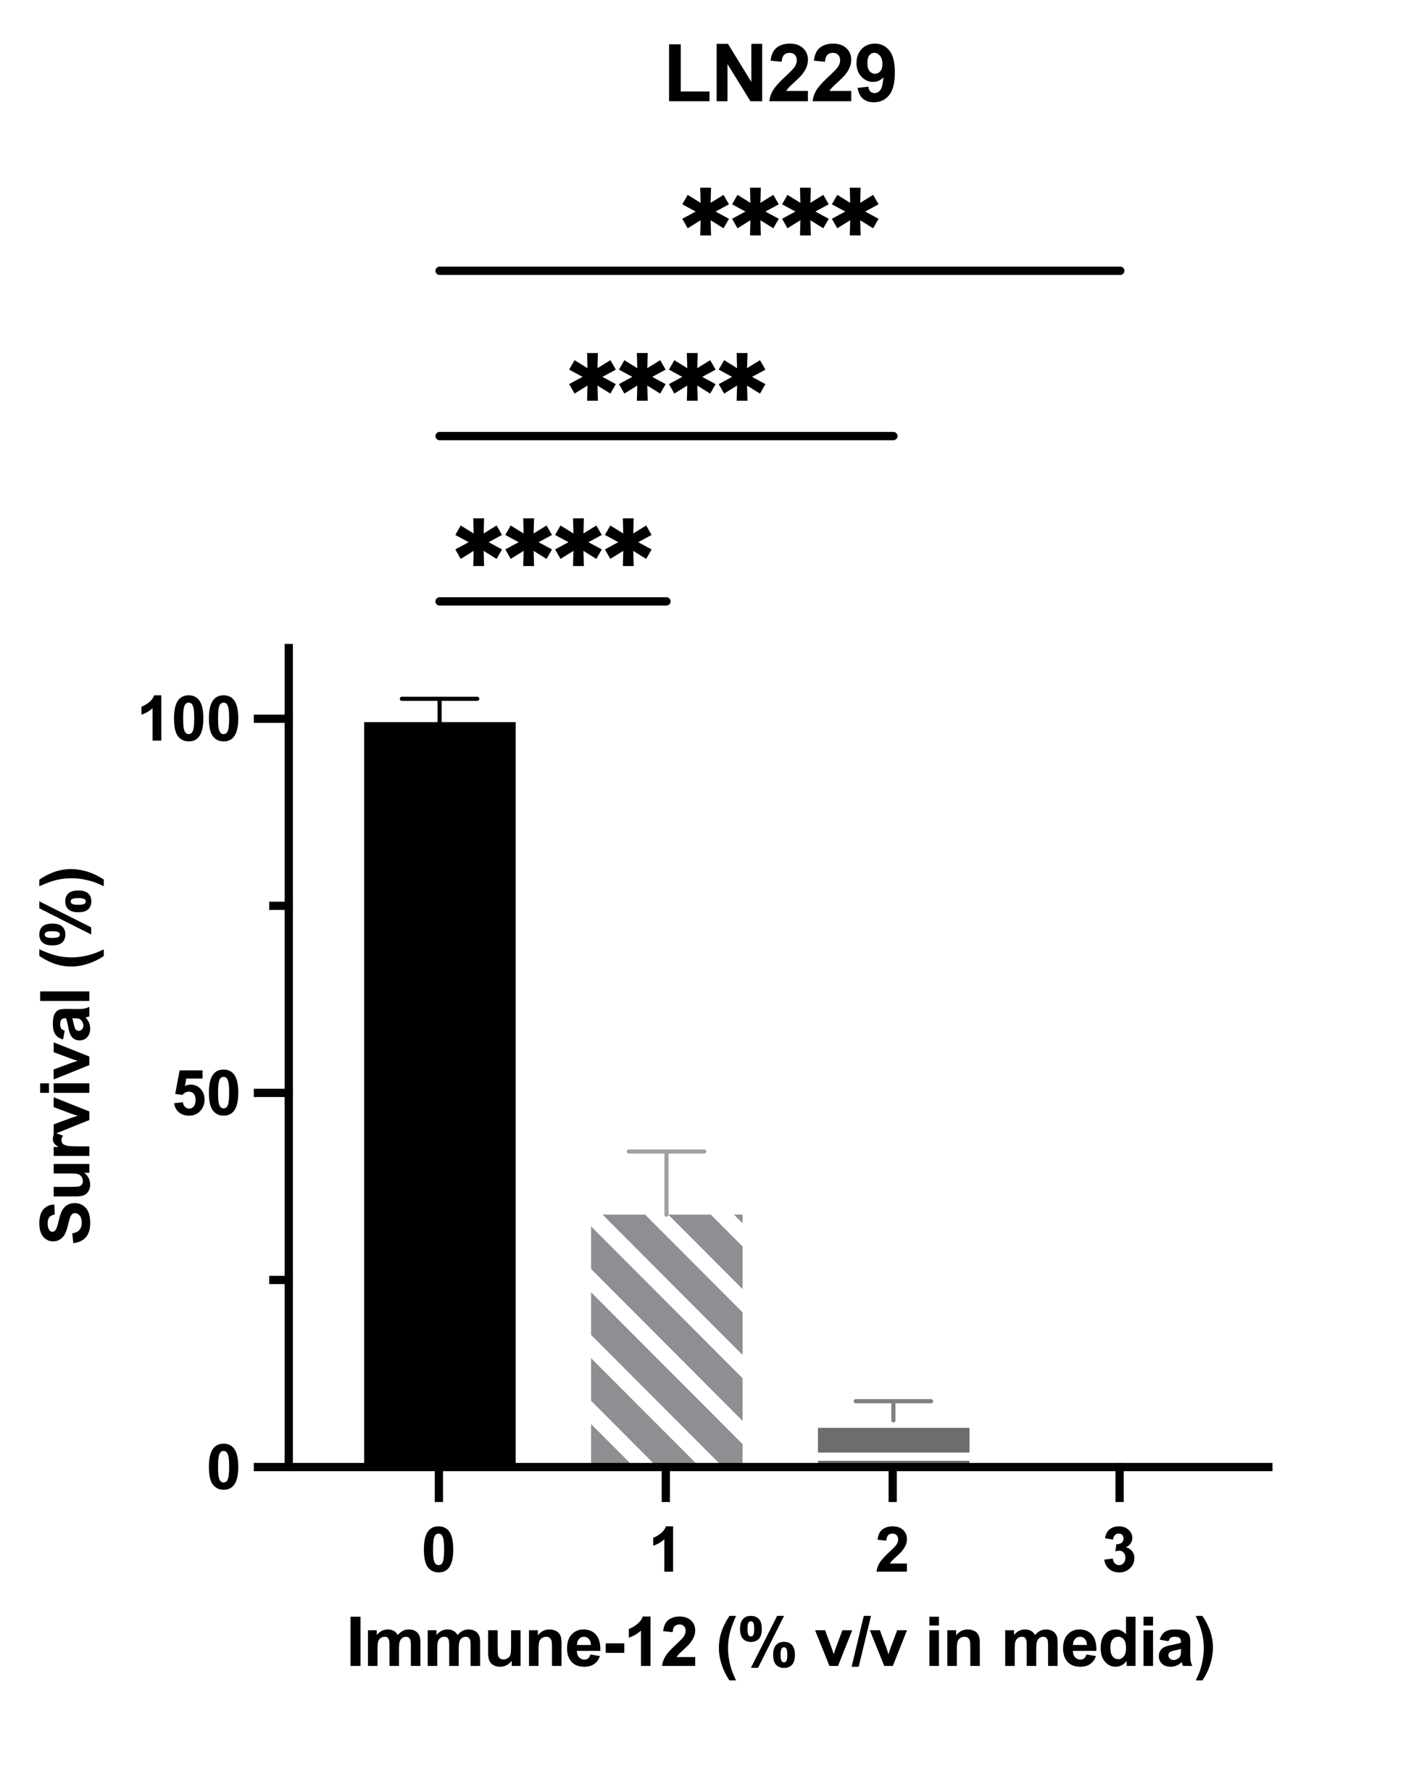
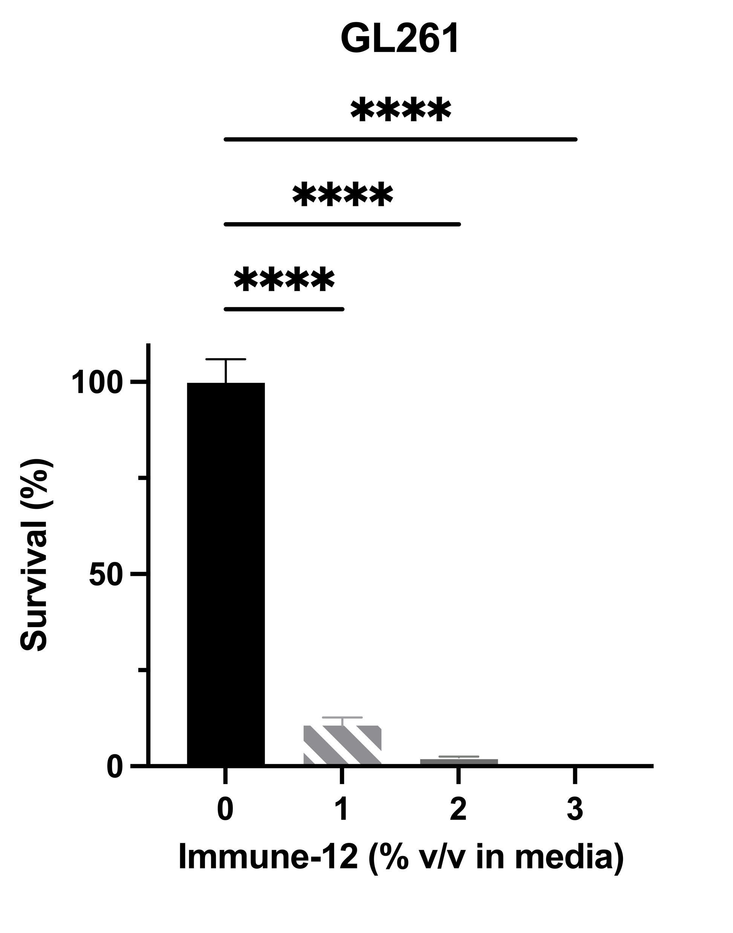
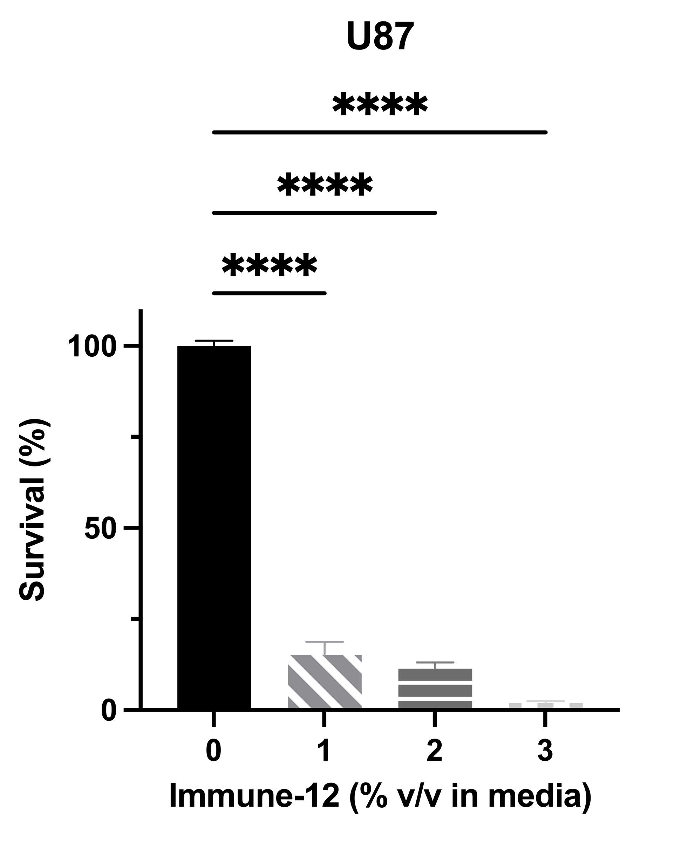
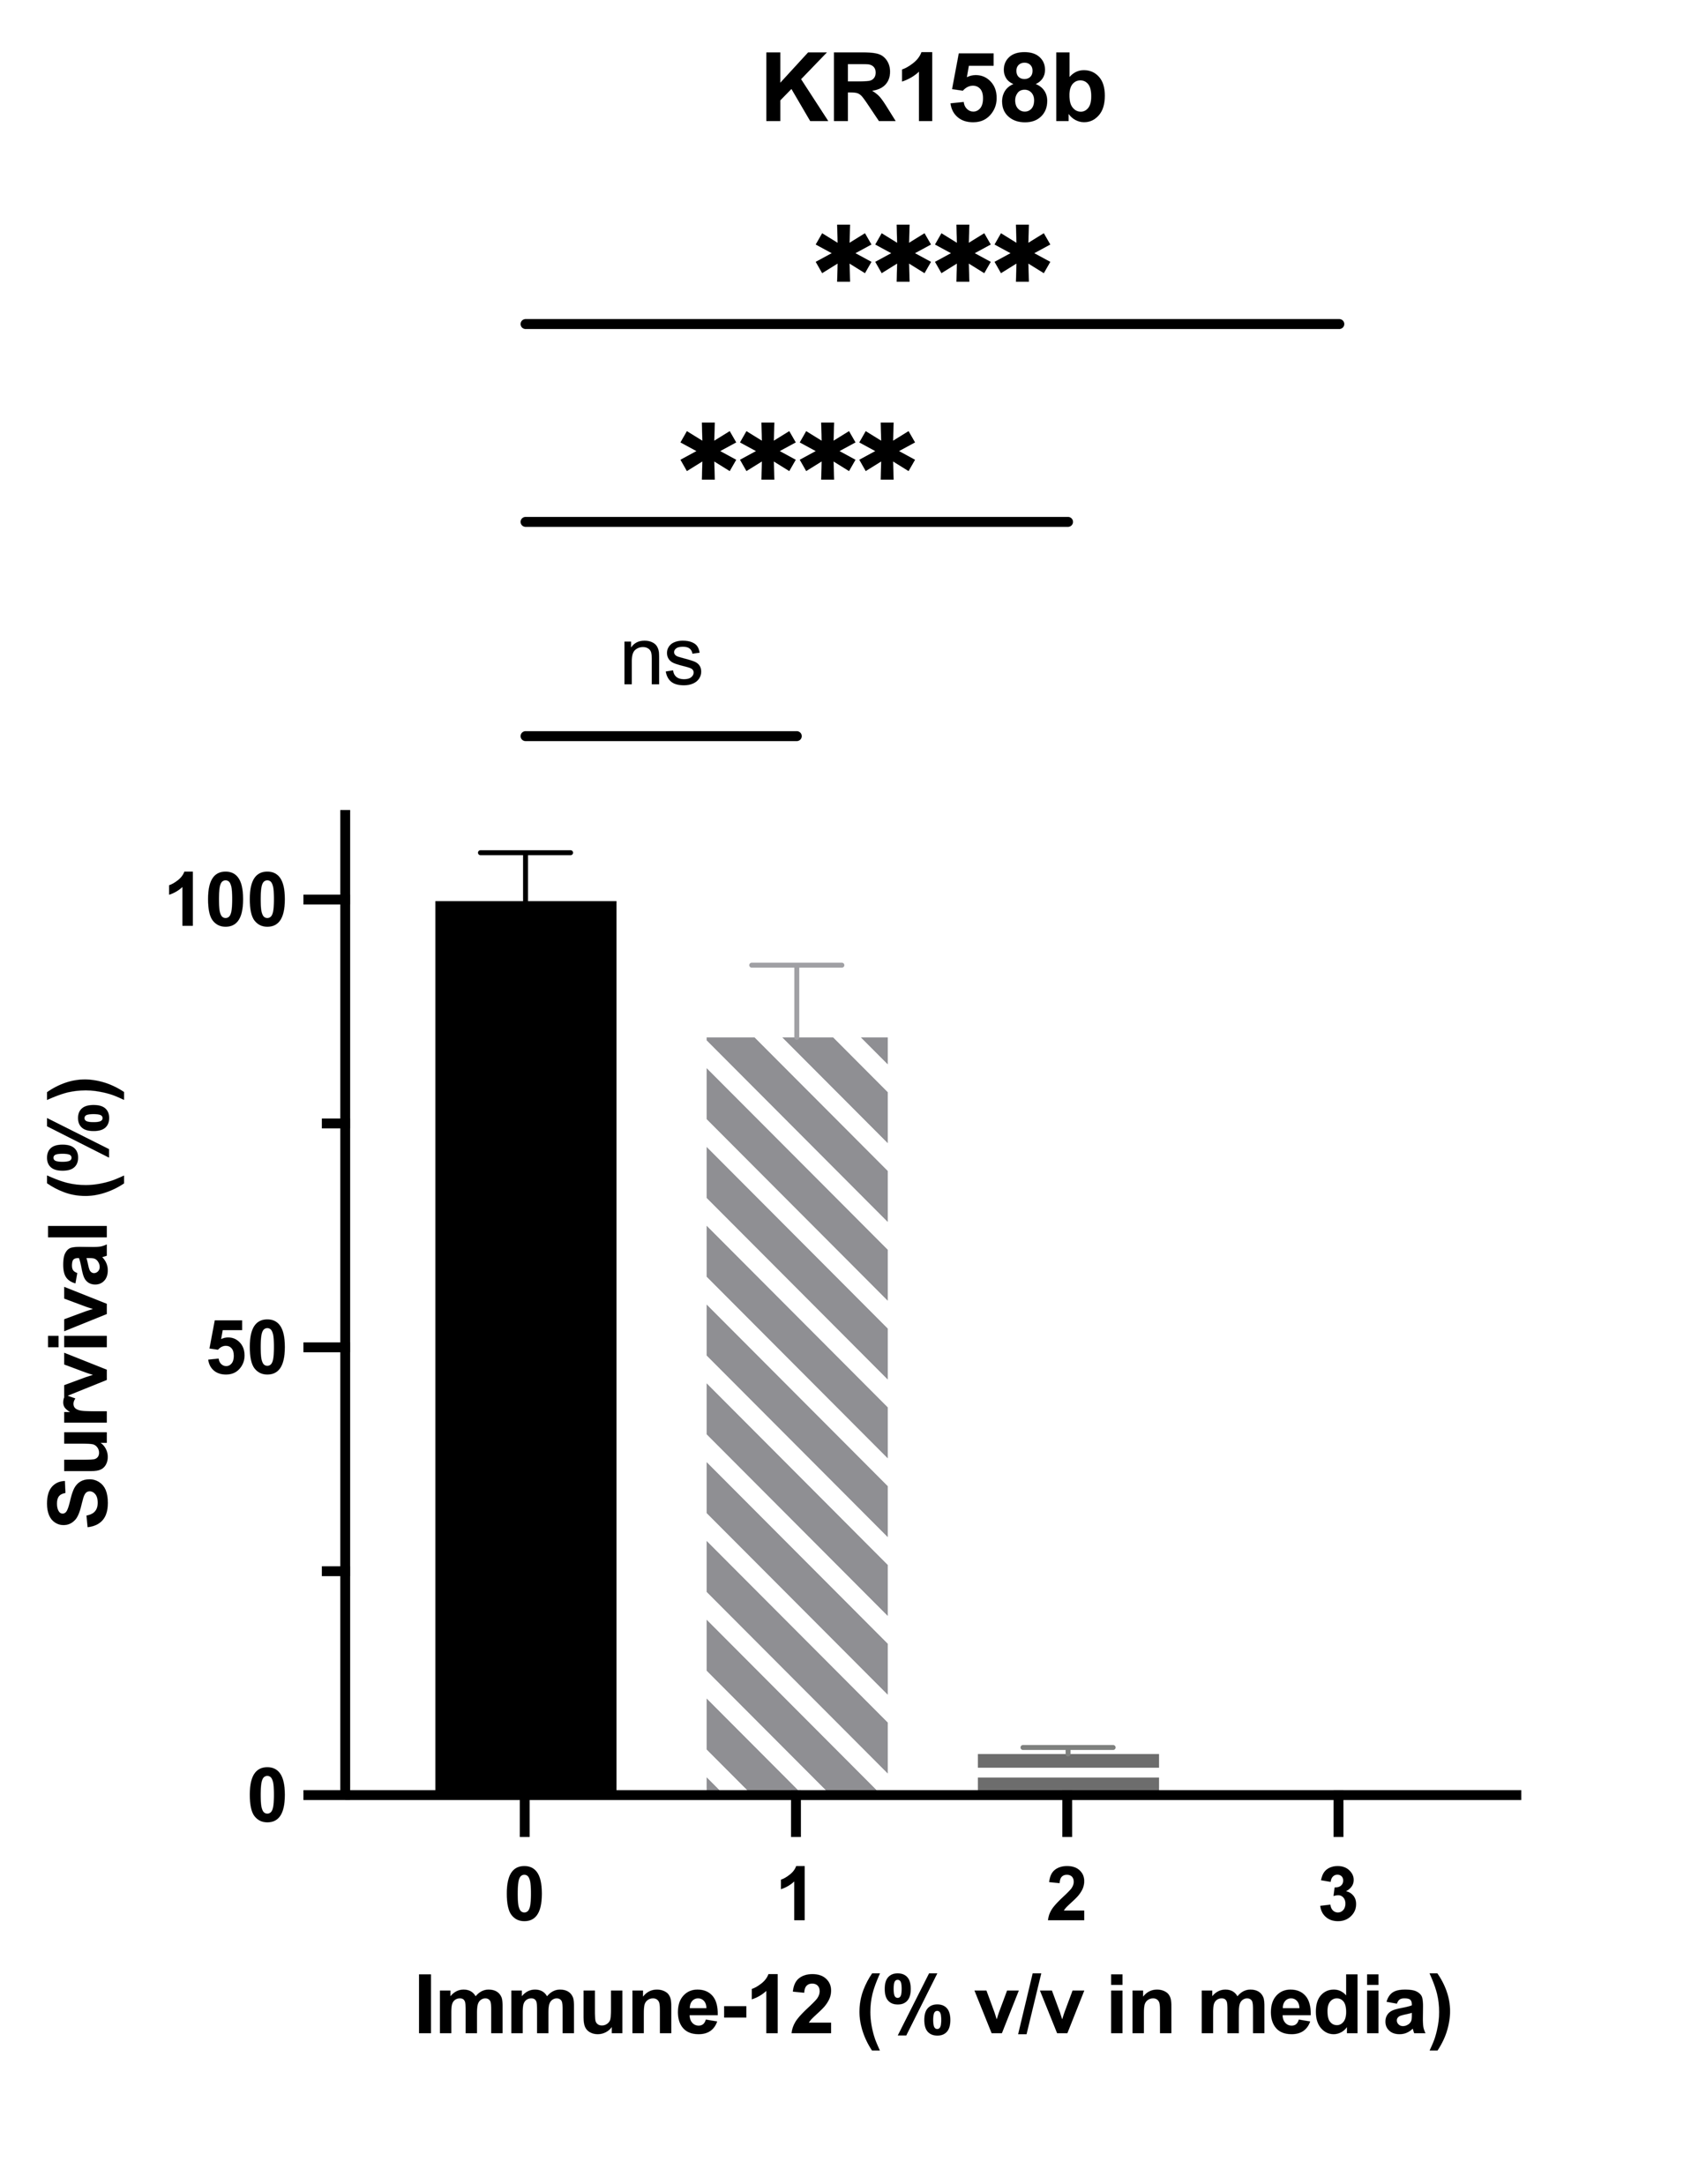
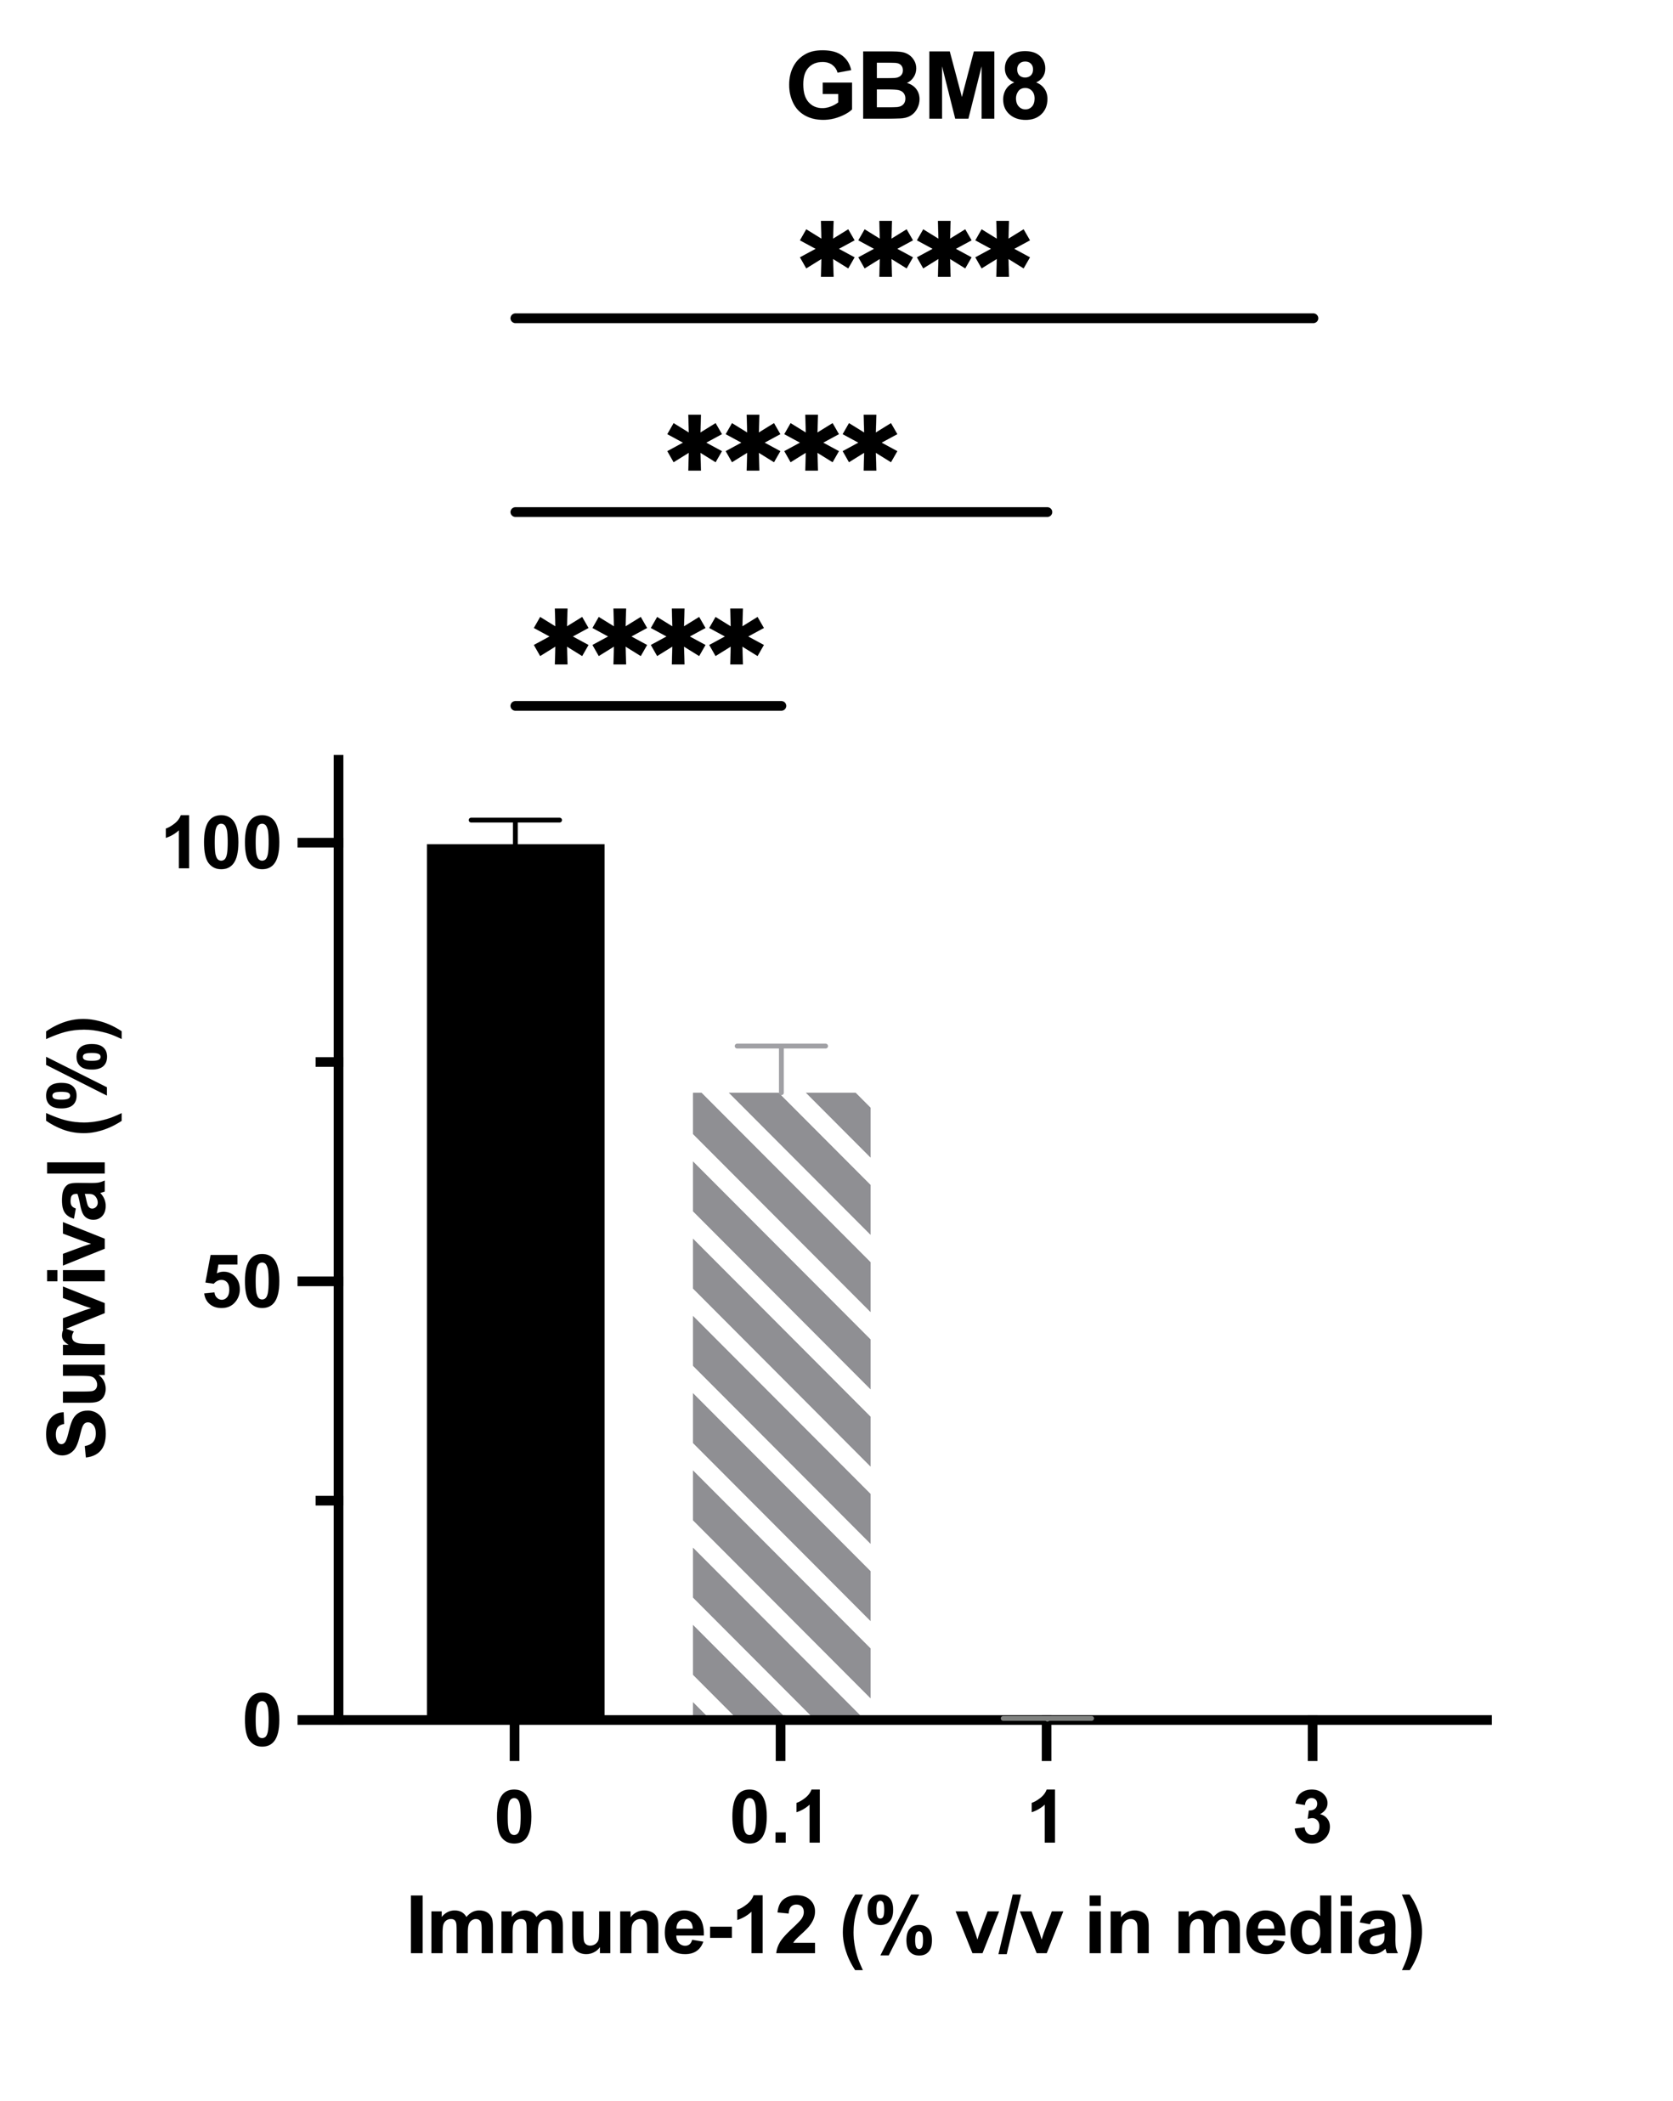
In Our Lab: Immune-12 Potently Kills GBM Cells In Vitro

Slide 7
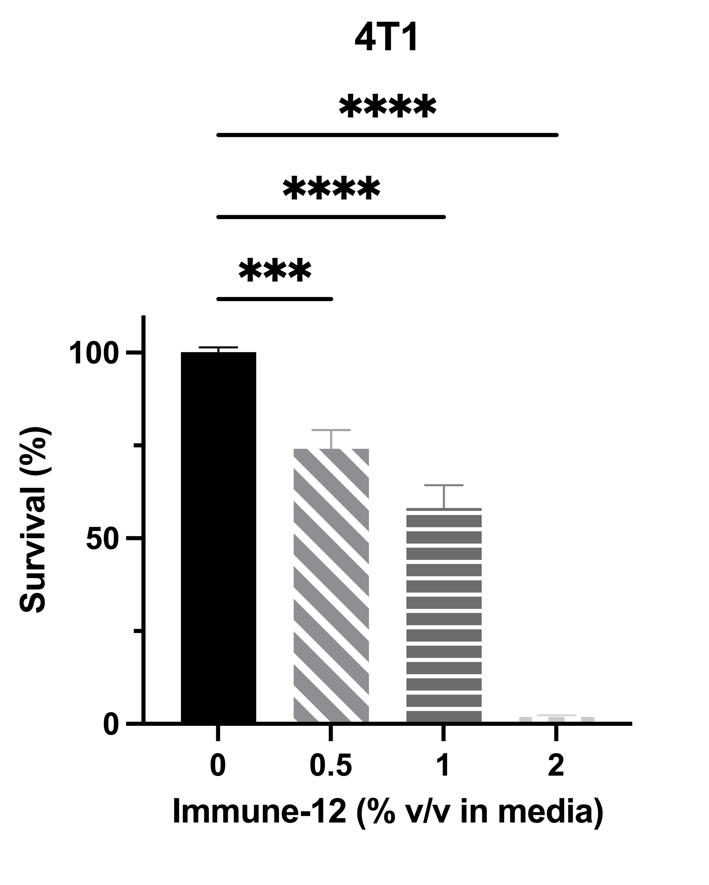
Immune-12 Potently Kills Other Cancer Cell Types In Vitro
Ovarian Cancer
Breast Cancer

Slide 8
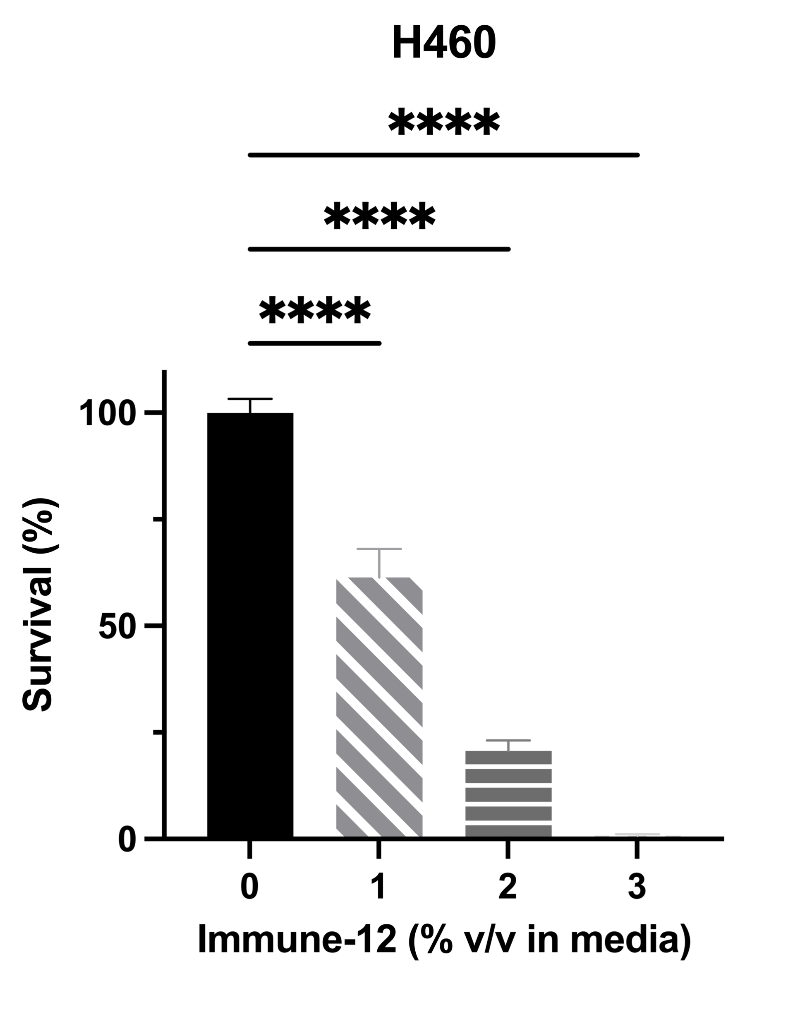
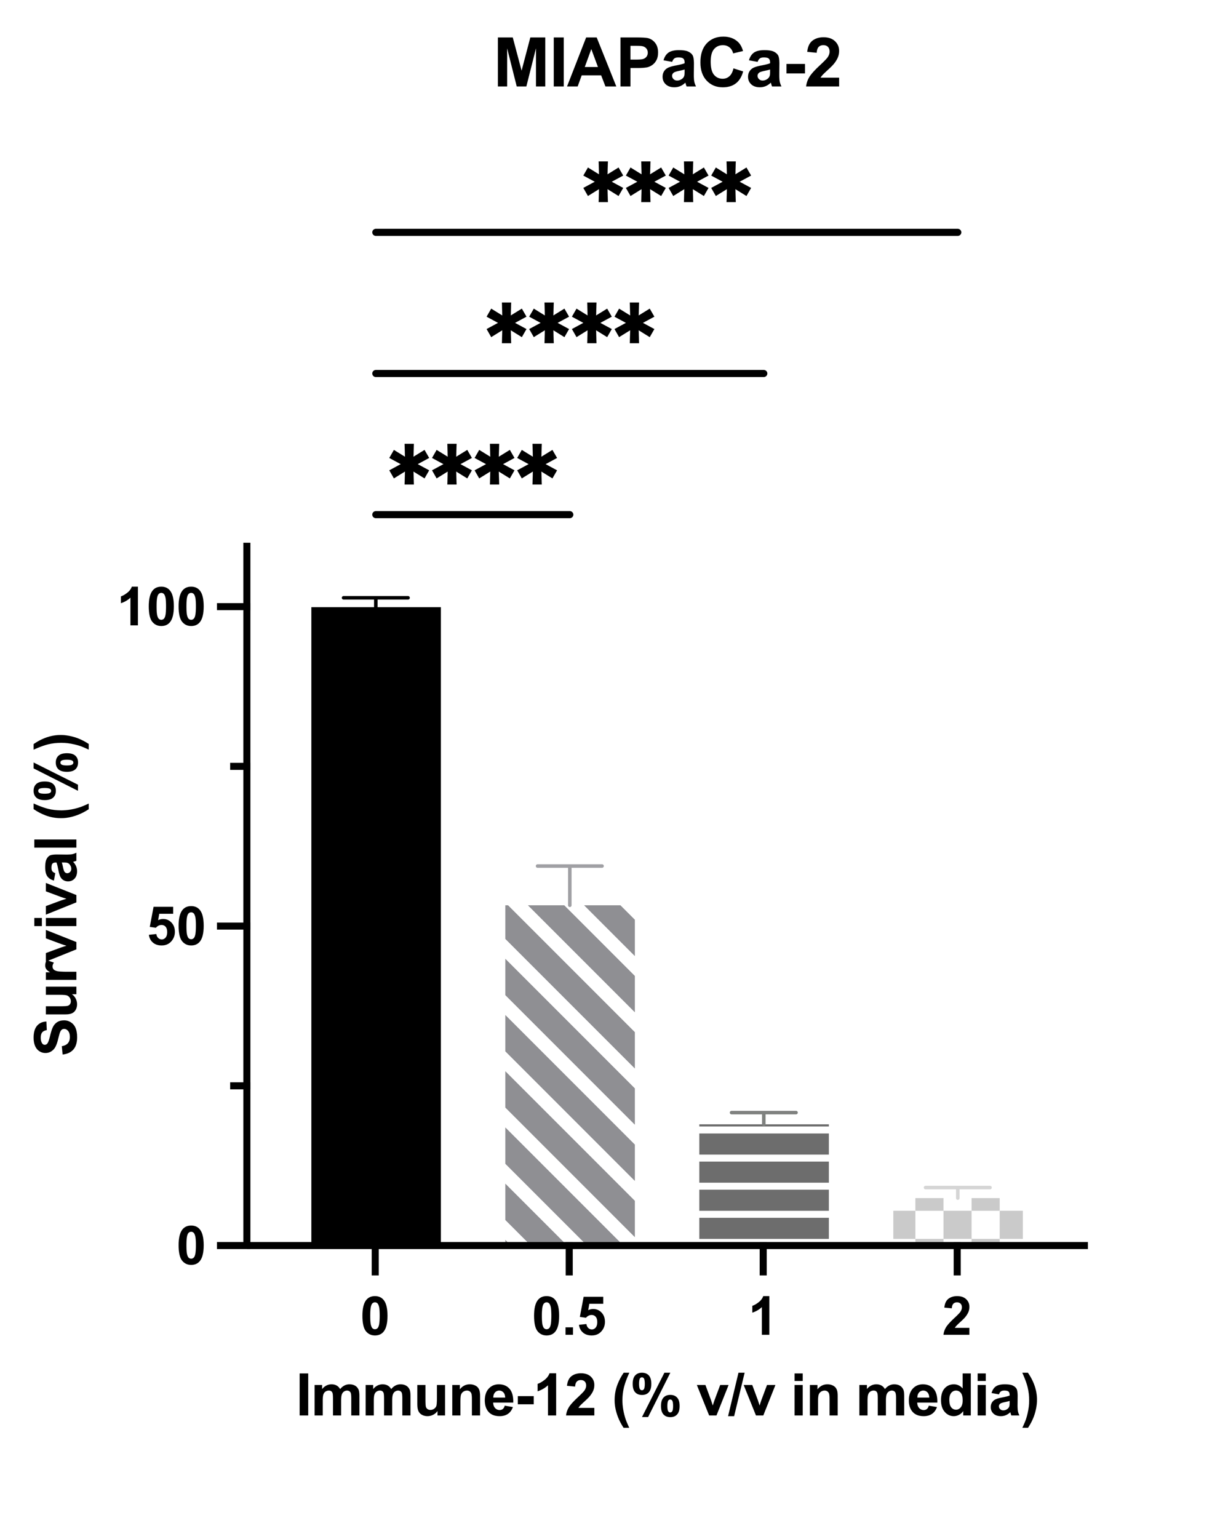
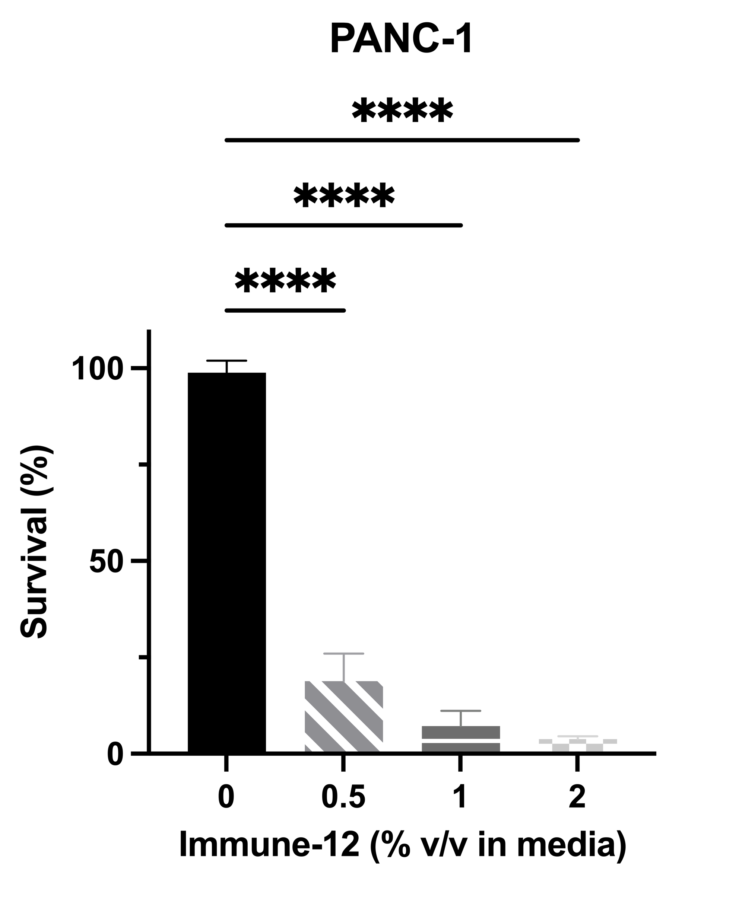
Immune-12 Potently Kills Other Cancer Cell Types In Vitro
Lung Cancer
Pancreatic Cancer

Slide 9
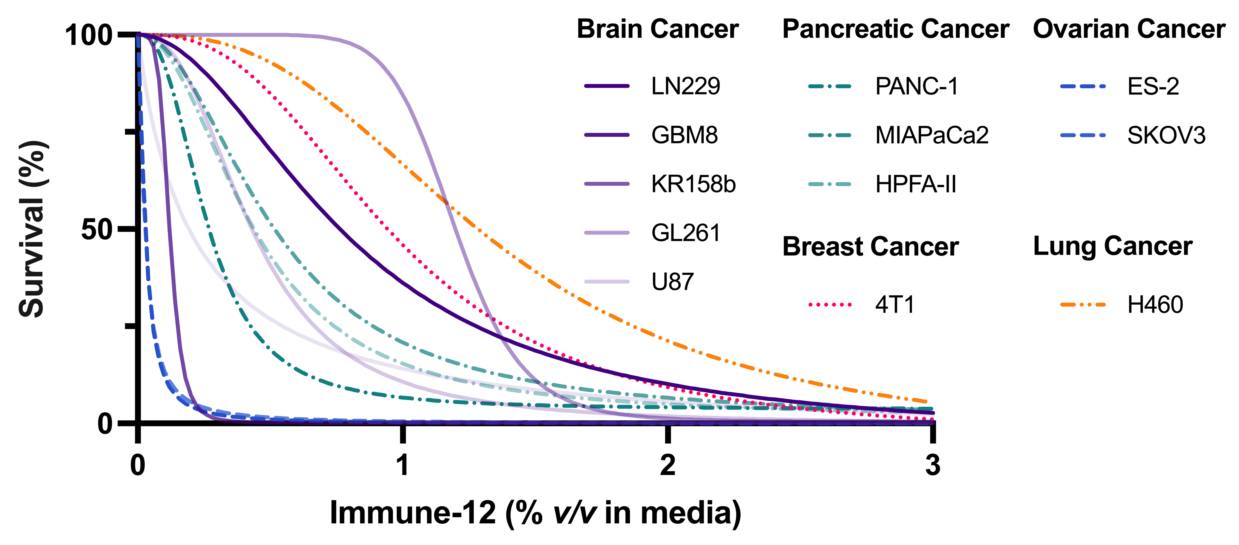
Variable Sensitivities of Cancer Cells to Immune-12 May Help Us Determine the Mechanism of Action

Slide 10
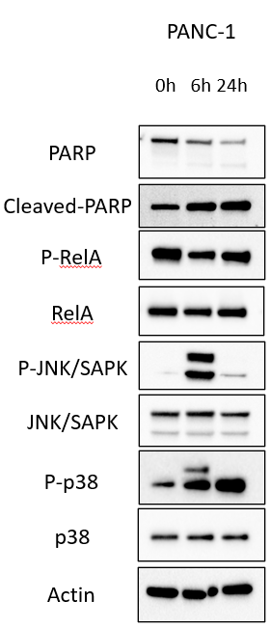
Immune-12 May Partially Function via p-JNK + p-p38 Induction
0h 6h 24h
0h 6h 24h
*
*

Slide 11
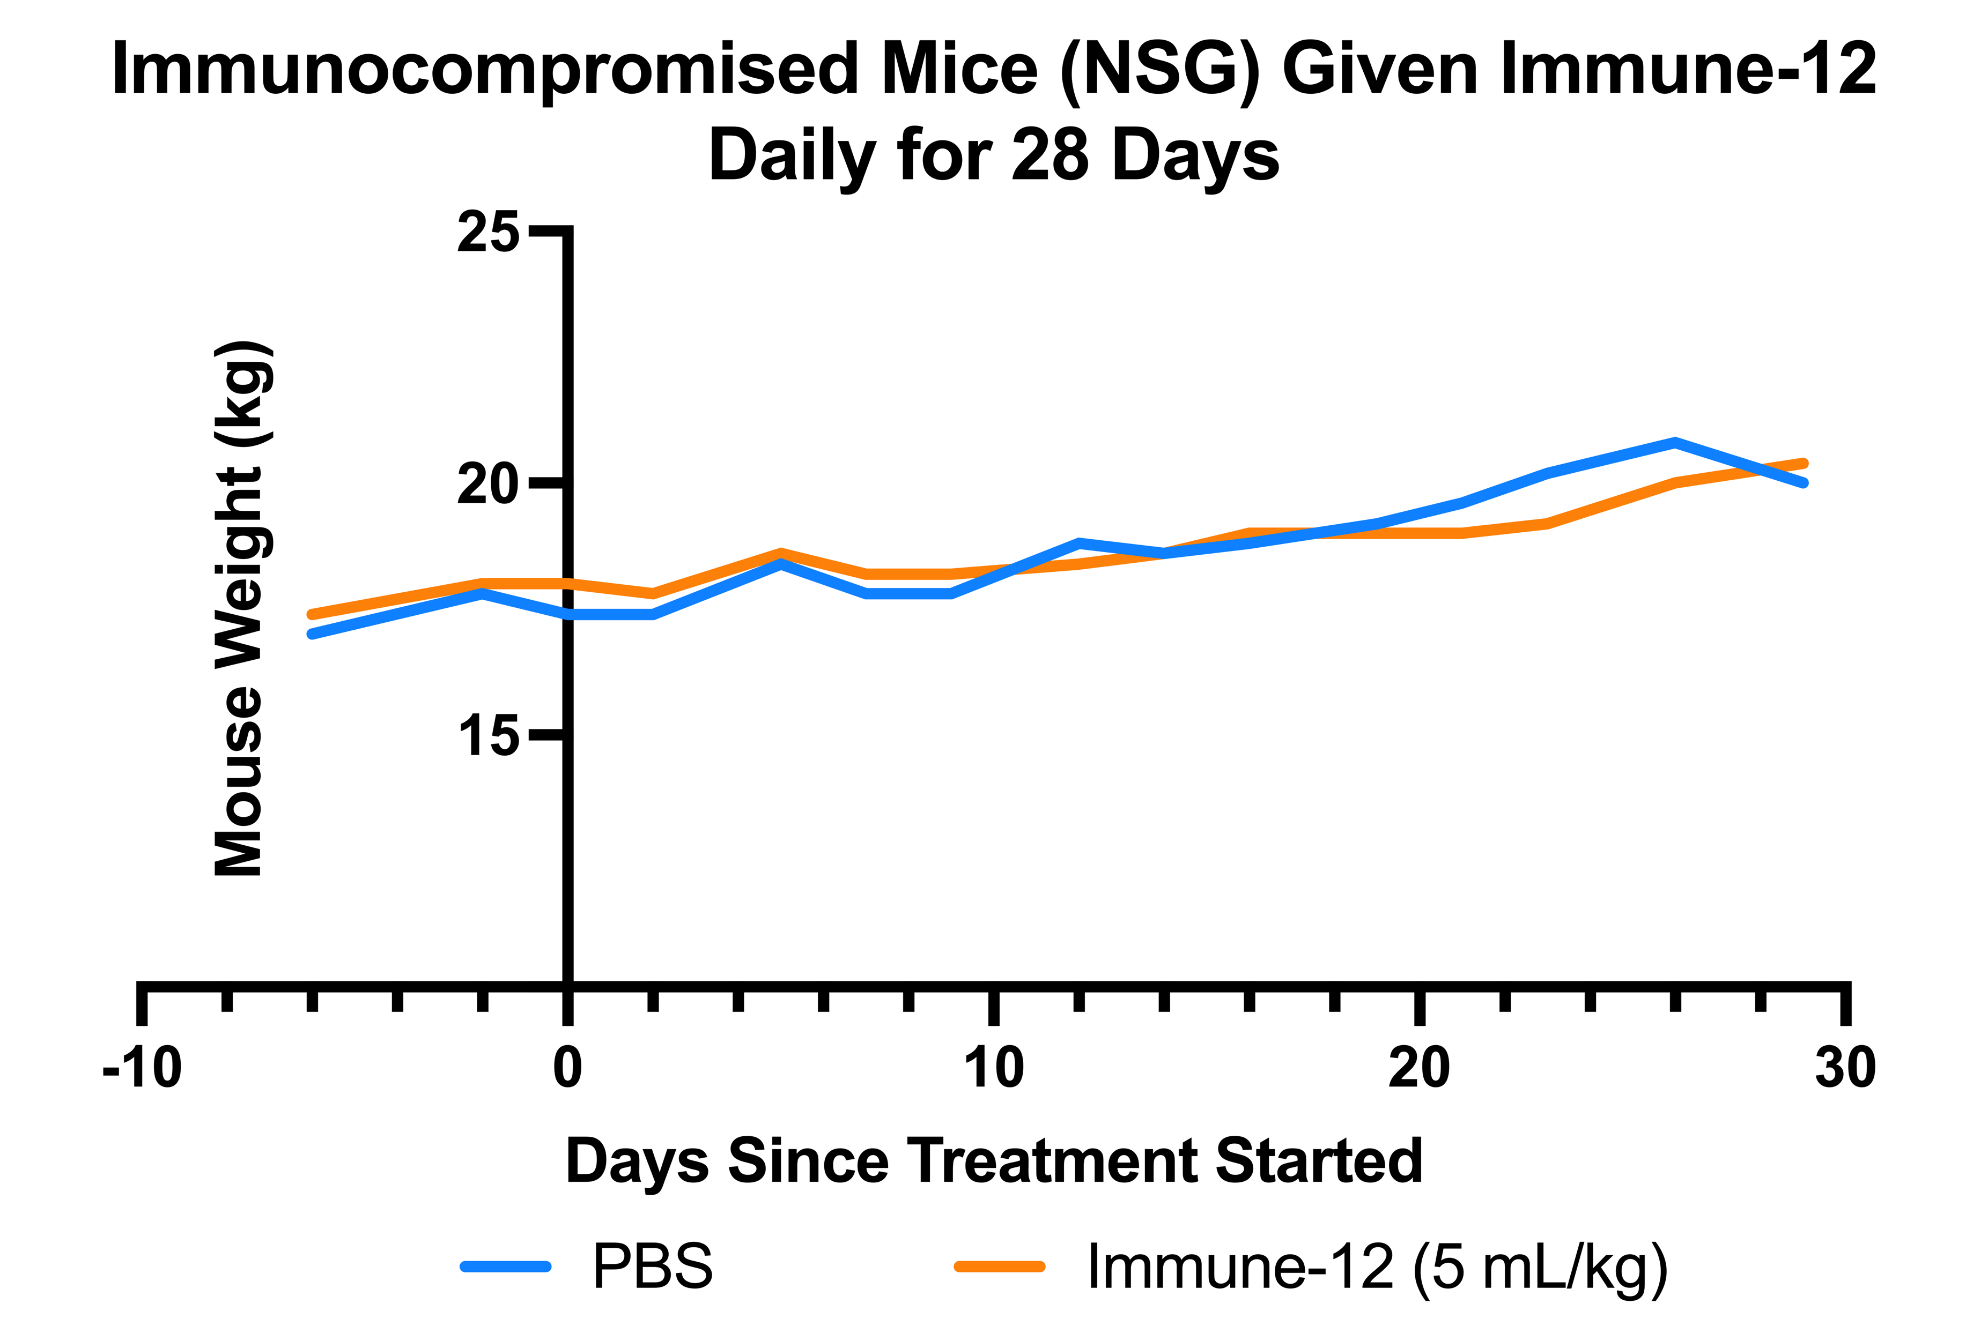
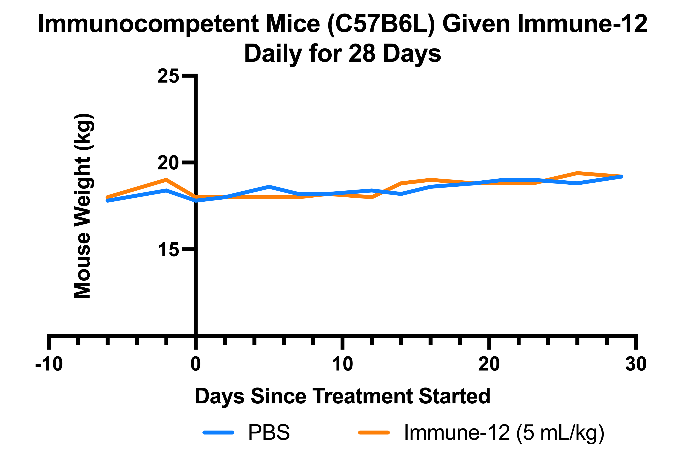
Immune-12 Is Not Toxic to Mice after 28 Days of Daily Treatment

Slide 12
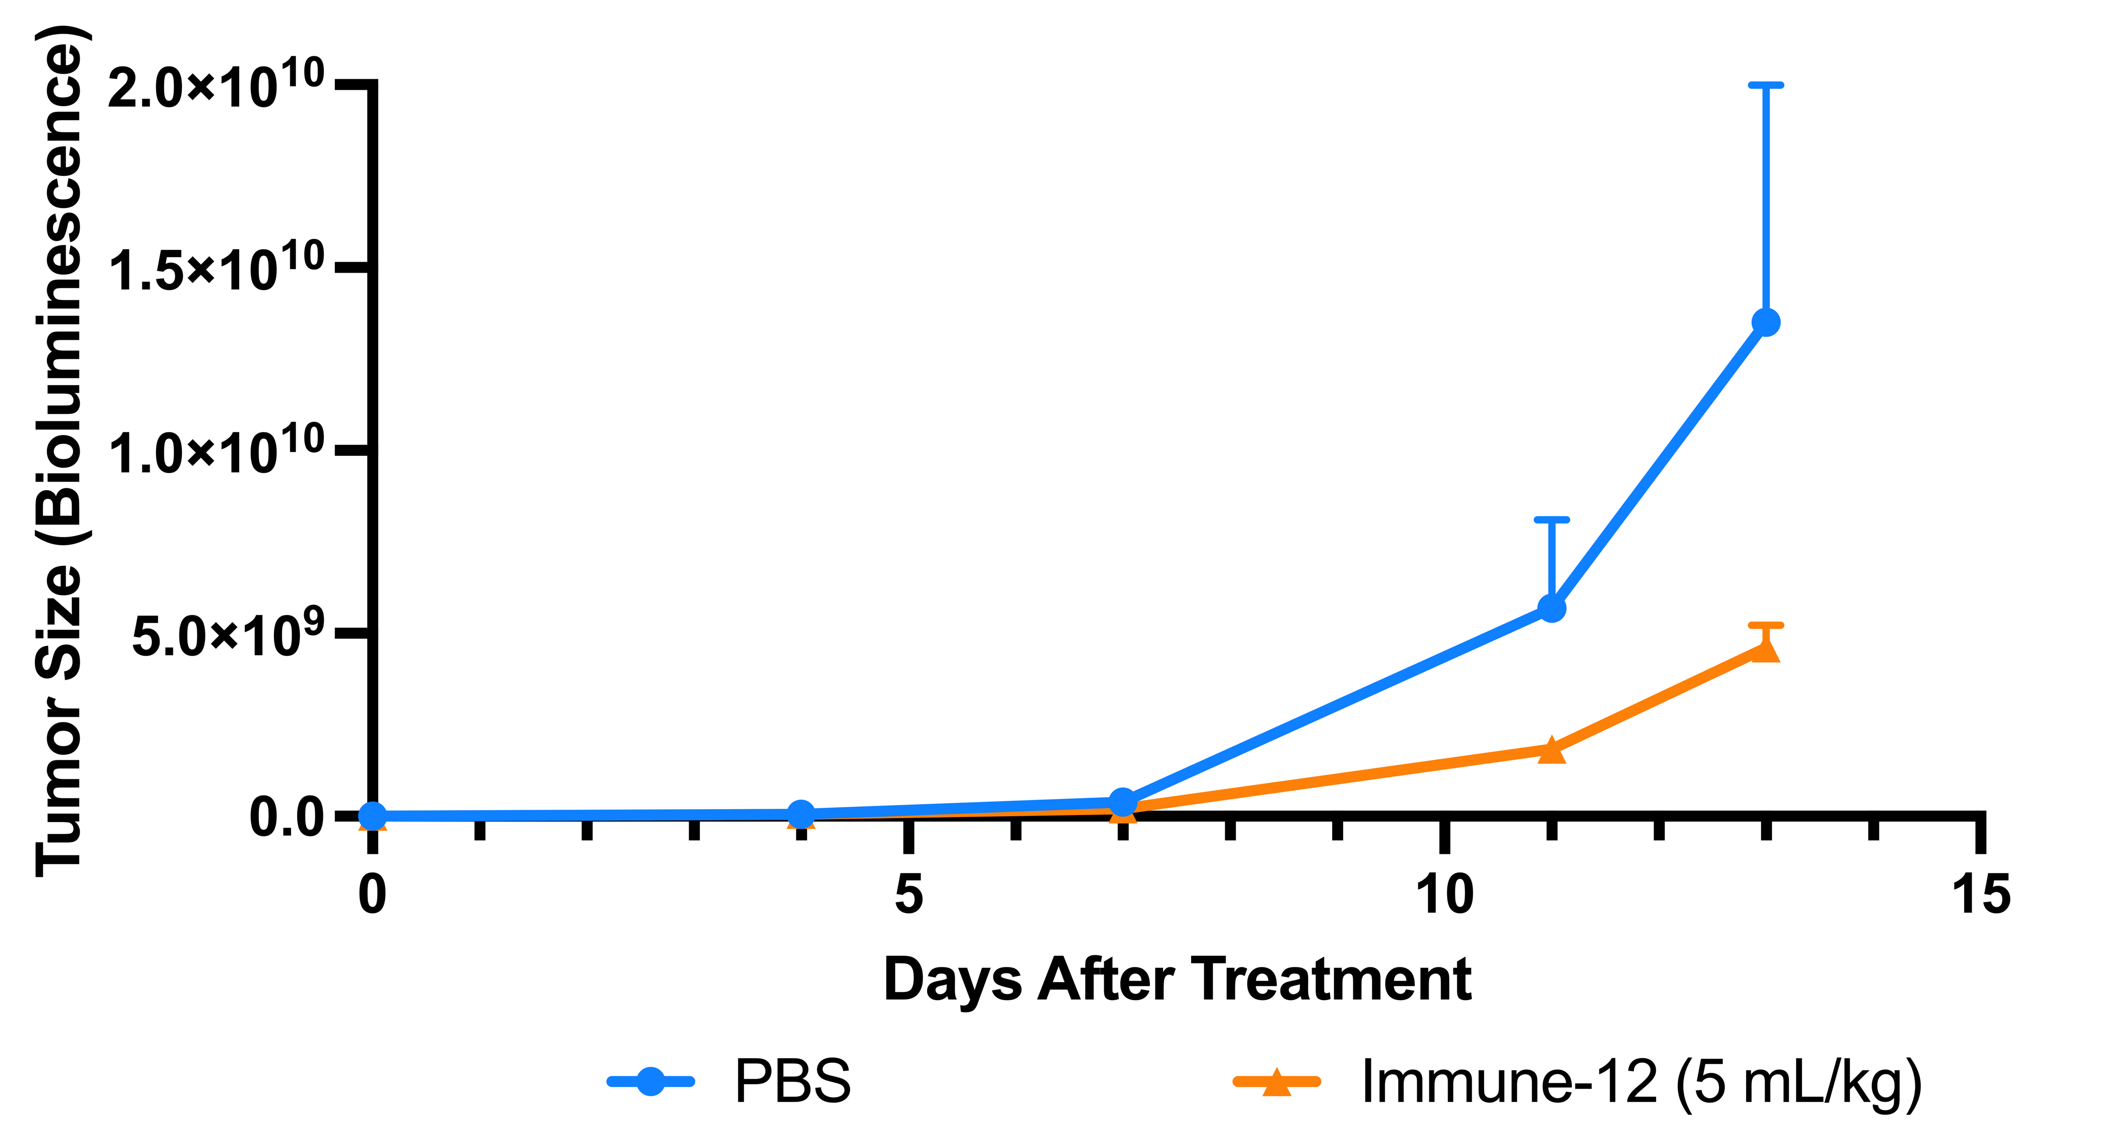
Immune-12 Induces Tumor Growth Inhibition in Mice with Orthotopically Implanted Murine GBM

Slide 13
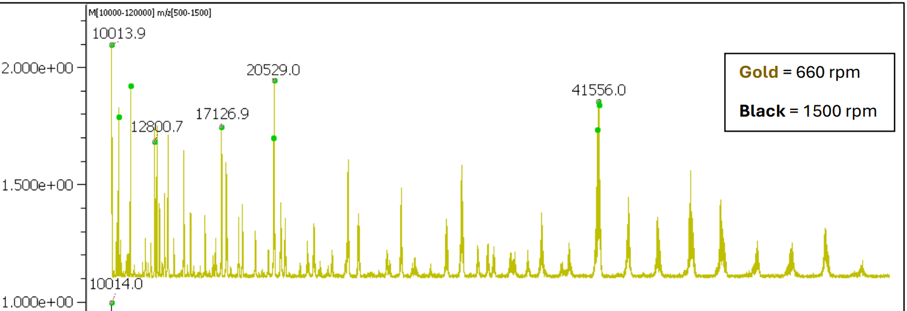
Immune-12 Contains a Multitude of Proteins
Deconvoluted Mass Spectrum
***Proteomic Analyses have identified several instances of known tumor suppressors within Immune-12

Slide 14
Future Directions
Batch-To-Batch Consistency in Potency:
Working Directly with Immune-12 Manufacturers
Testing multiple packets per batch vs multiple cell lines
Measuring stability over time
In Vivo Experiments:
Completed/Ongoing:
Toxicity Profile
Initial Efficacy Study in GBM
Upcoming: Four simultaneous efficacy studies:
Orthotopic Tumor Implantations:
Brain
Ovarian Met
Breast
Pancreas
Treatment Groups:
Untreated
Start treatment shortly after tumor implant
Start treatment BEFORE tumor implant
Single and combination therapy
Potency Across Multiple Tumor Lines:
Completed (12):
Brain – 5
Pancreas – 3
Ovarian – 2
Breast – 1
Lung – 1
Upcoming (8):
Lung – 1
Leukemia – 1
Breast – 2
Bladder – 1
Gastric – 1
Colorectal – 1
Immune-12
Proteomic Characterization:
Now: Packet-to-packet and batch-to-batch consistency of proteomic and metabolomic fingerprint
Upcoming: Fractionate Immune-12 to home in on where antitumor potency lies
Microbiome:
Ongoing experiment: Whole Genome Sequencing of 90 fecal samples from healthy NSG and C57BL6 mice after 0, 14, and 28 days of daily Immune-12 treatment
Testing on Uncultured Patient Brain Tumor Tissues
The Satterlee Lab’s organotypic brain slice culture technology can engraft, treat, and analyze patient brain tumors just after resection

